Slide 1
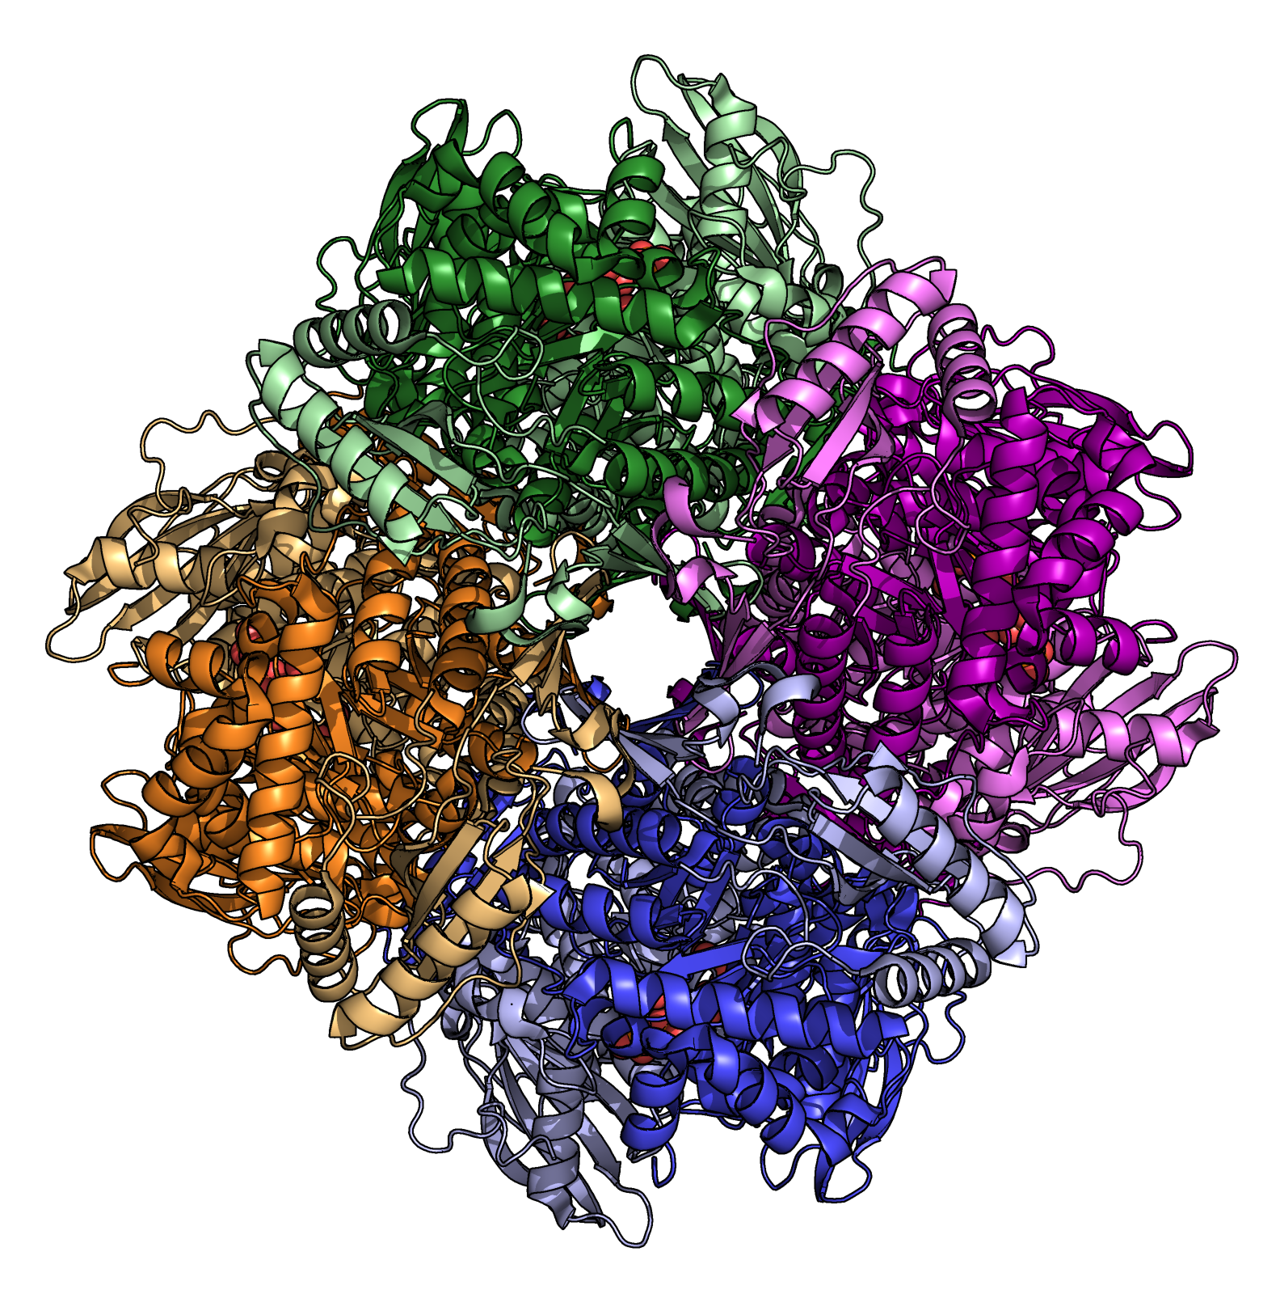
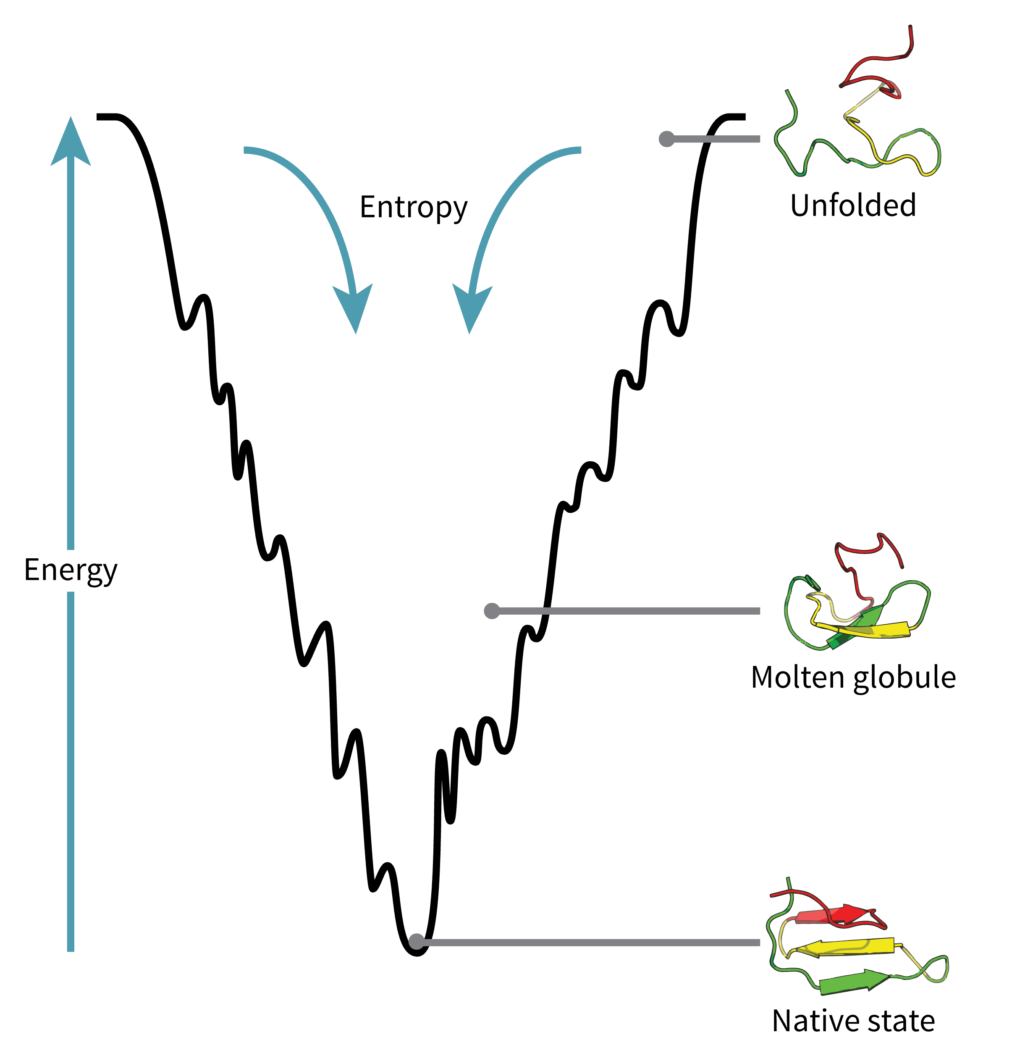


Protein
Structure &
Thermodynamics
Workshop
10th February 2025
Dr. Amanda Souza Câmara, IPK
Dr. Victor H. Rabesquine Nogueira, IPK
Prof. Dr. Antônio José da Costa Filho, University of São Paulo

Slide 2
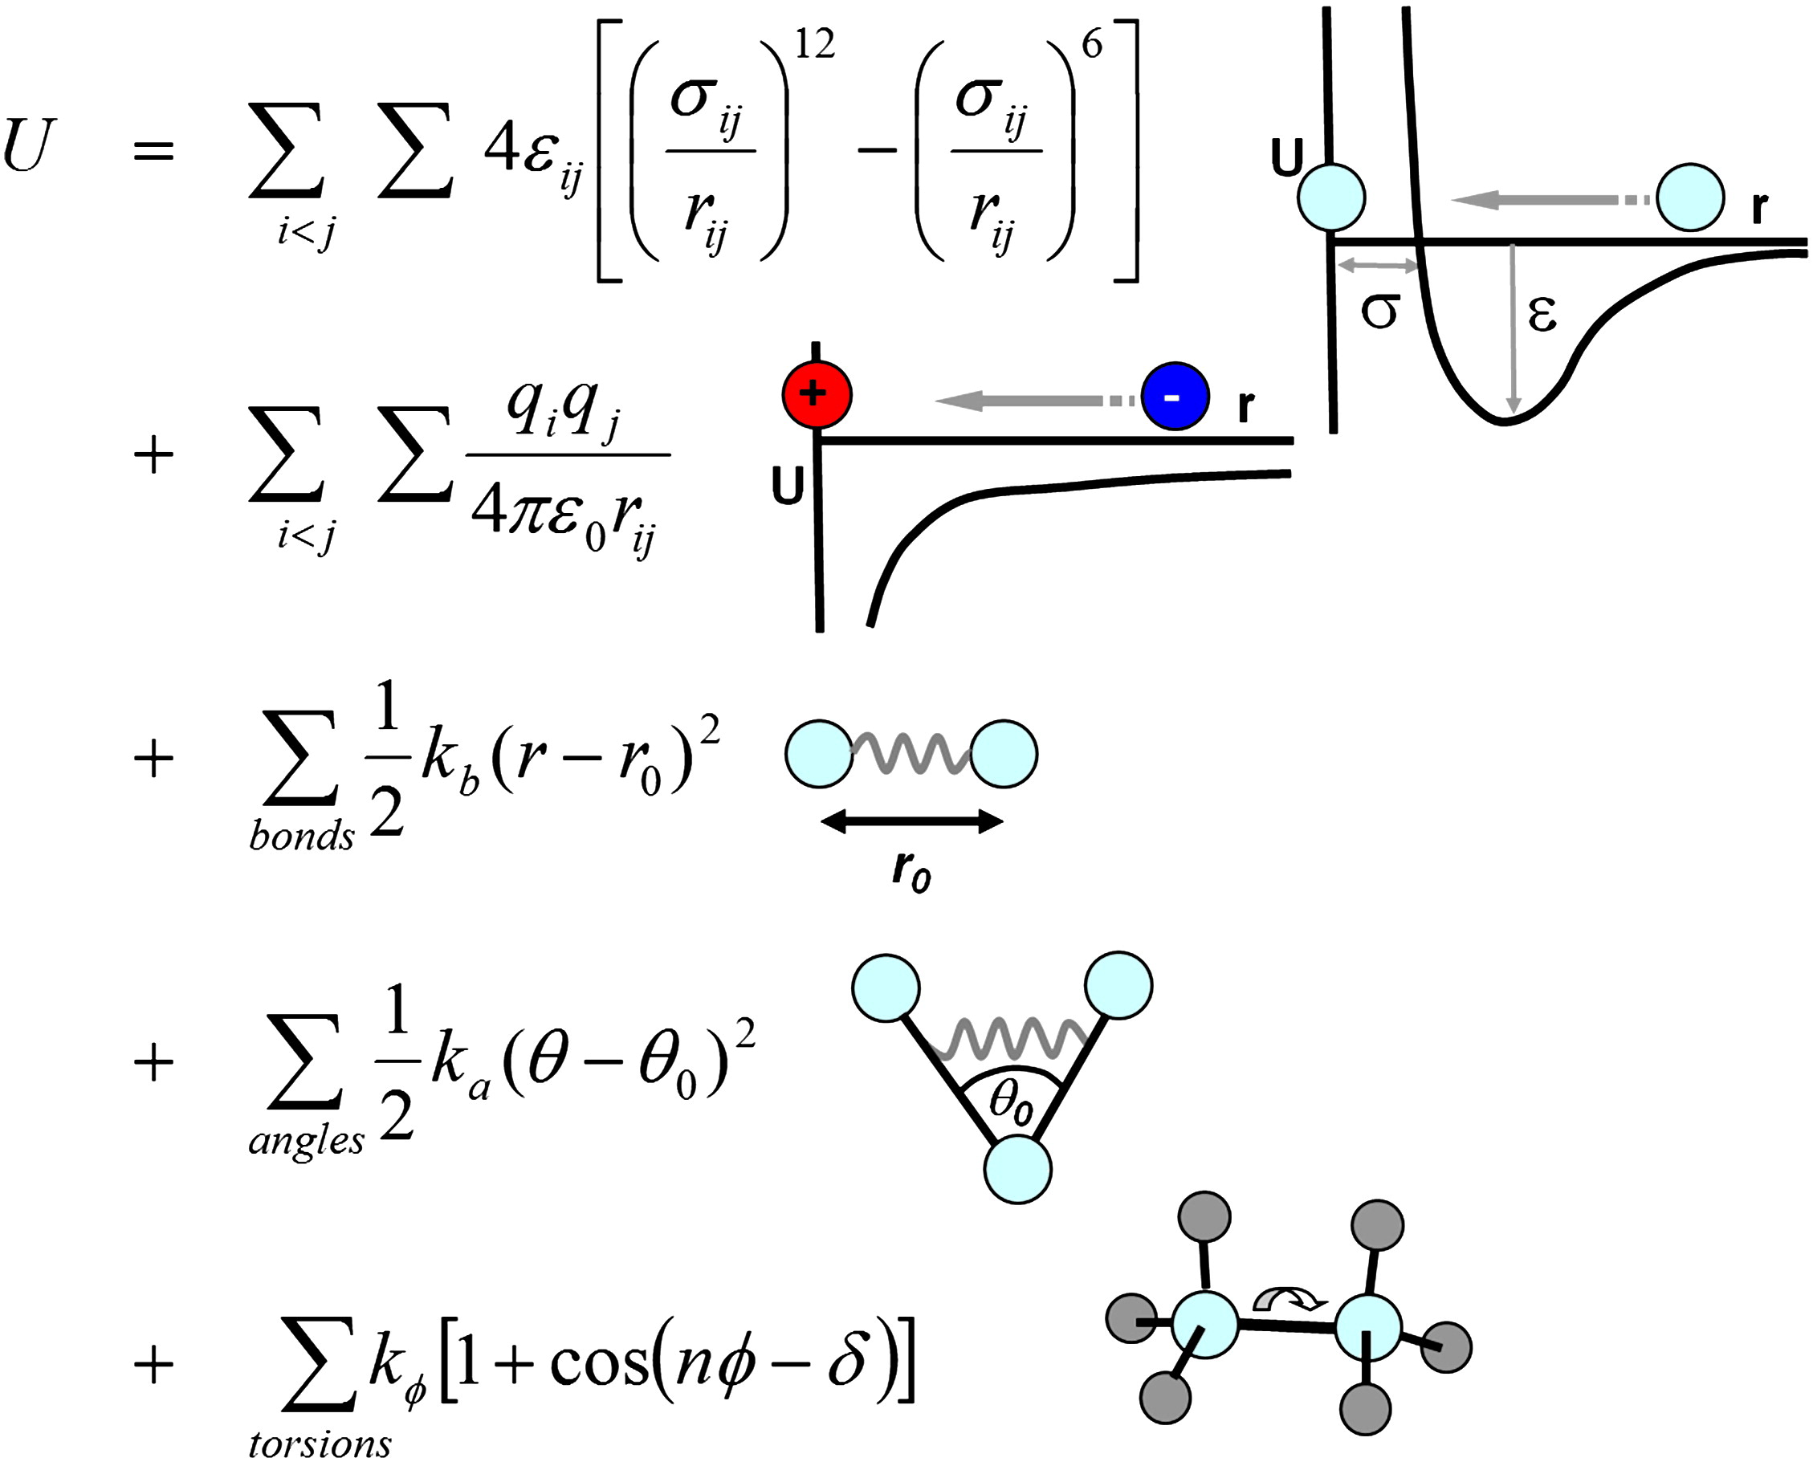
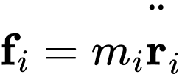
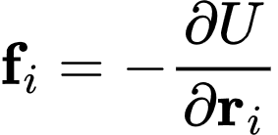
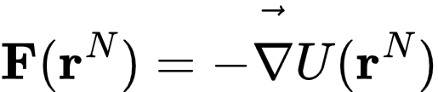
Molecular dynamics
https://doi.org/10.1016/j.addr.2012.02.011

Slide 3
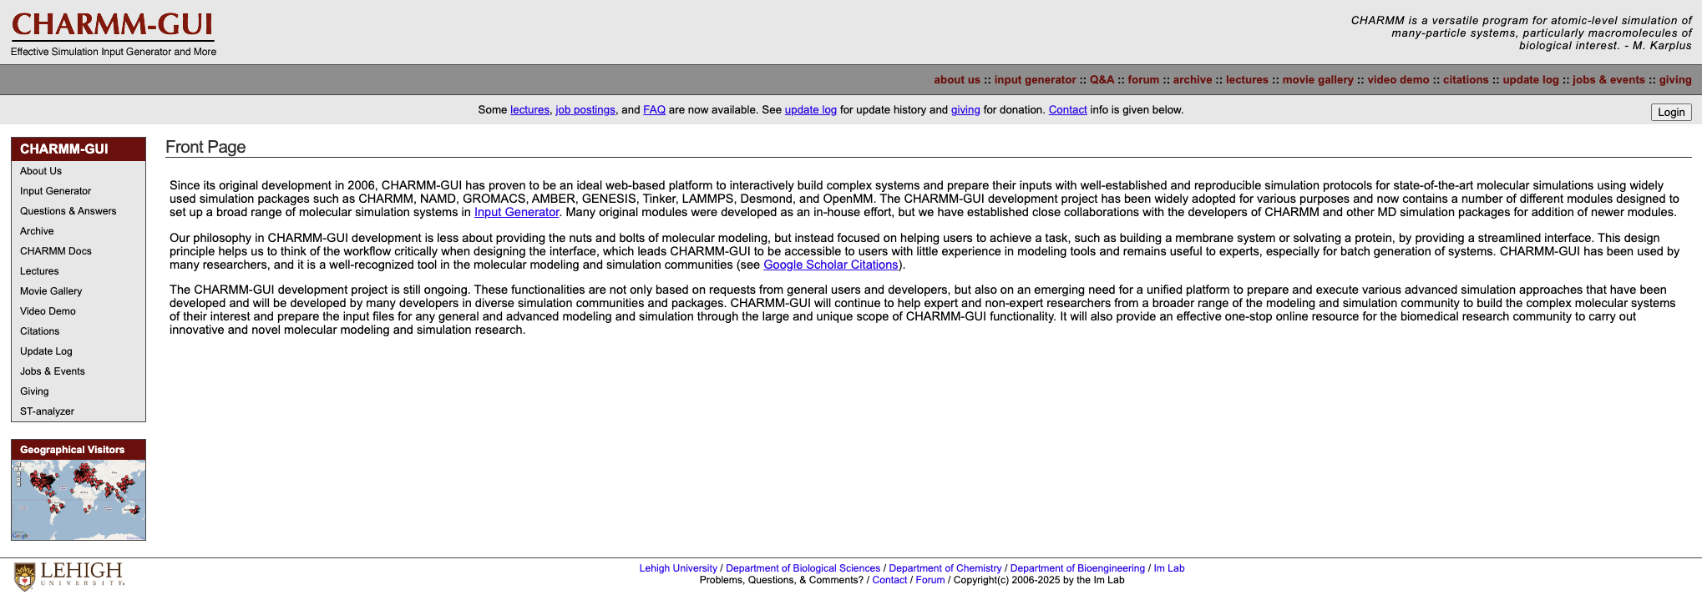
Input files preparation
For this tutorial, we will use the CHARMM-GUI Platform. Developed and maintained by the Im Lab at Lehigh University, USA, this is a powerful and convenient tool that helps you to prepare the input files for your molecular dynamics simulations.

Slide 4
Input files preparation
For this tutorial, we will use the CHARMM-GUI Platform. Developed and maintained by the Im Lab at Lehigh University, USA, this is a powerful and convenient tool that helps you to prepare the input files for your molecular dynamics simulations.
Access https://www.charmm-gui.org/ and create your user account login by clicking in the “Login” button.

Slide 5
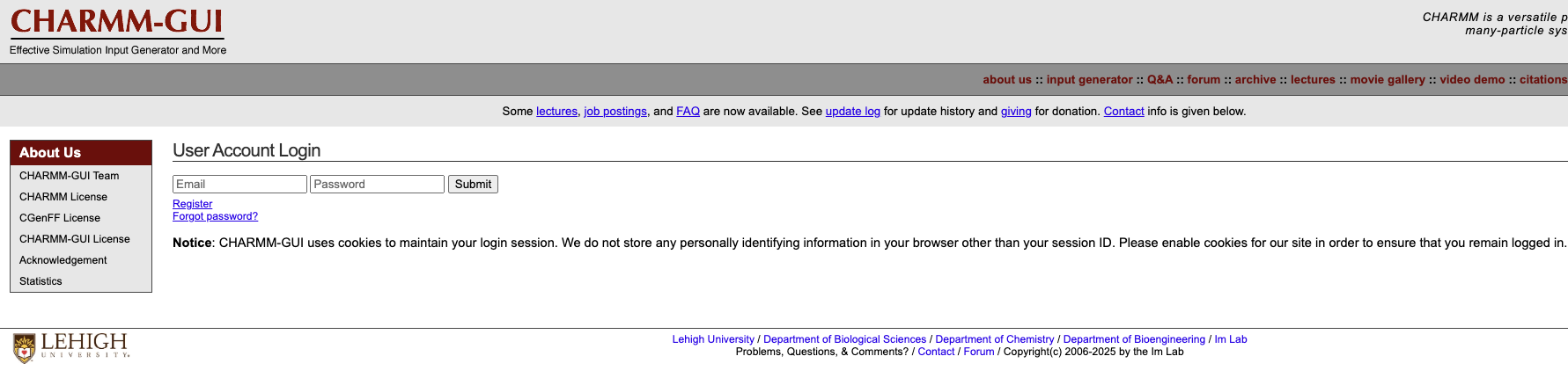
Input files preparation
To use the platform, you will have to register first by clicking on the “Register” button.

Slide 6
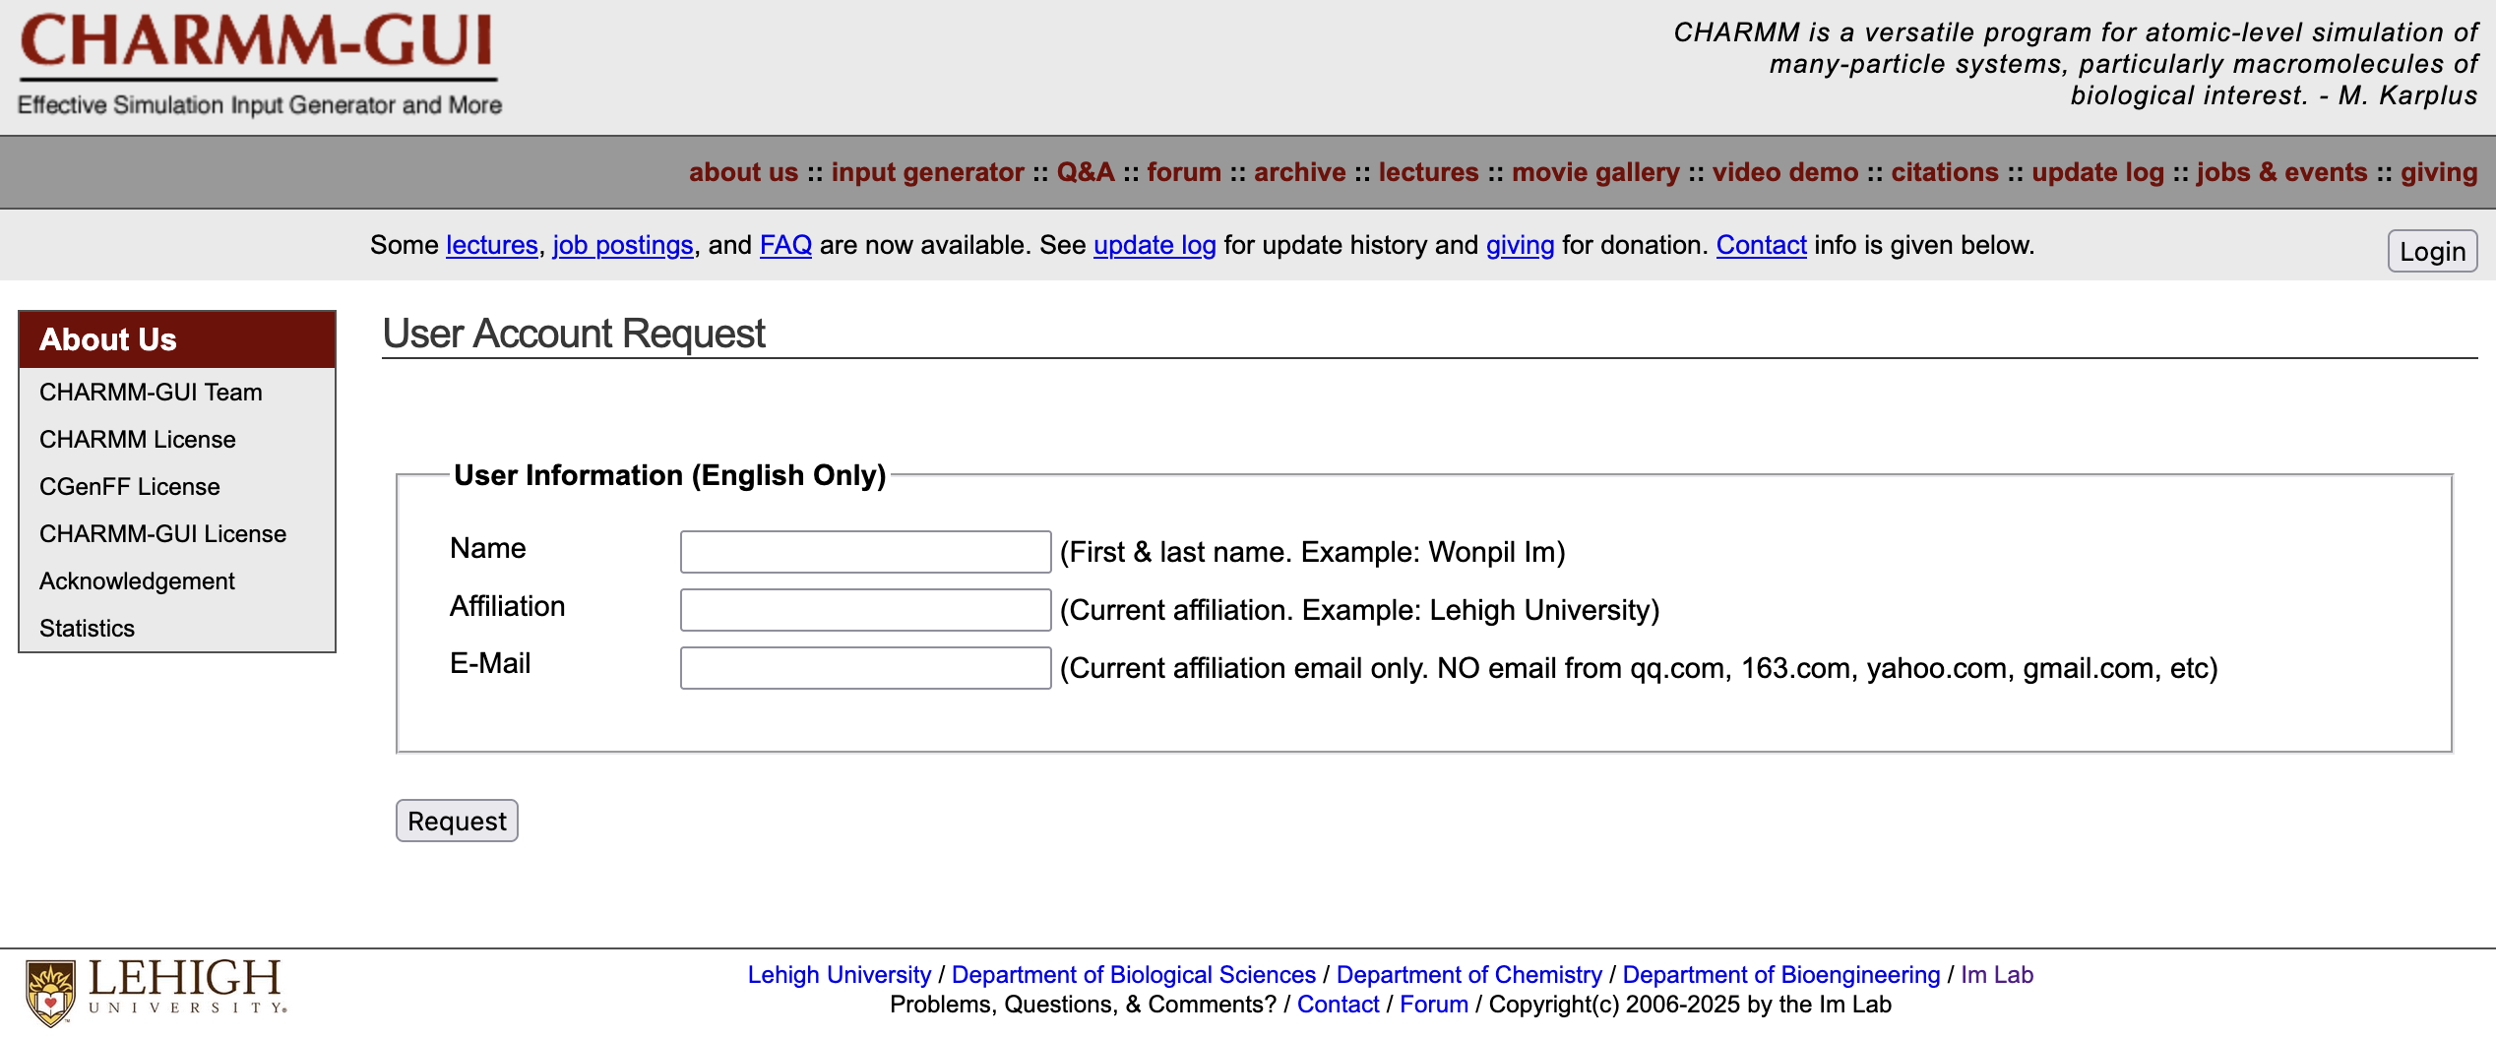
Input files preparation
Fill in your data to request access and receive the activation e-mail. It must take no longer than a couple of minutes.
After receiving it, follow their instructions to complete your registration to the platform.

Slide 7
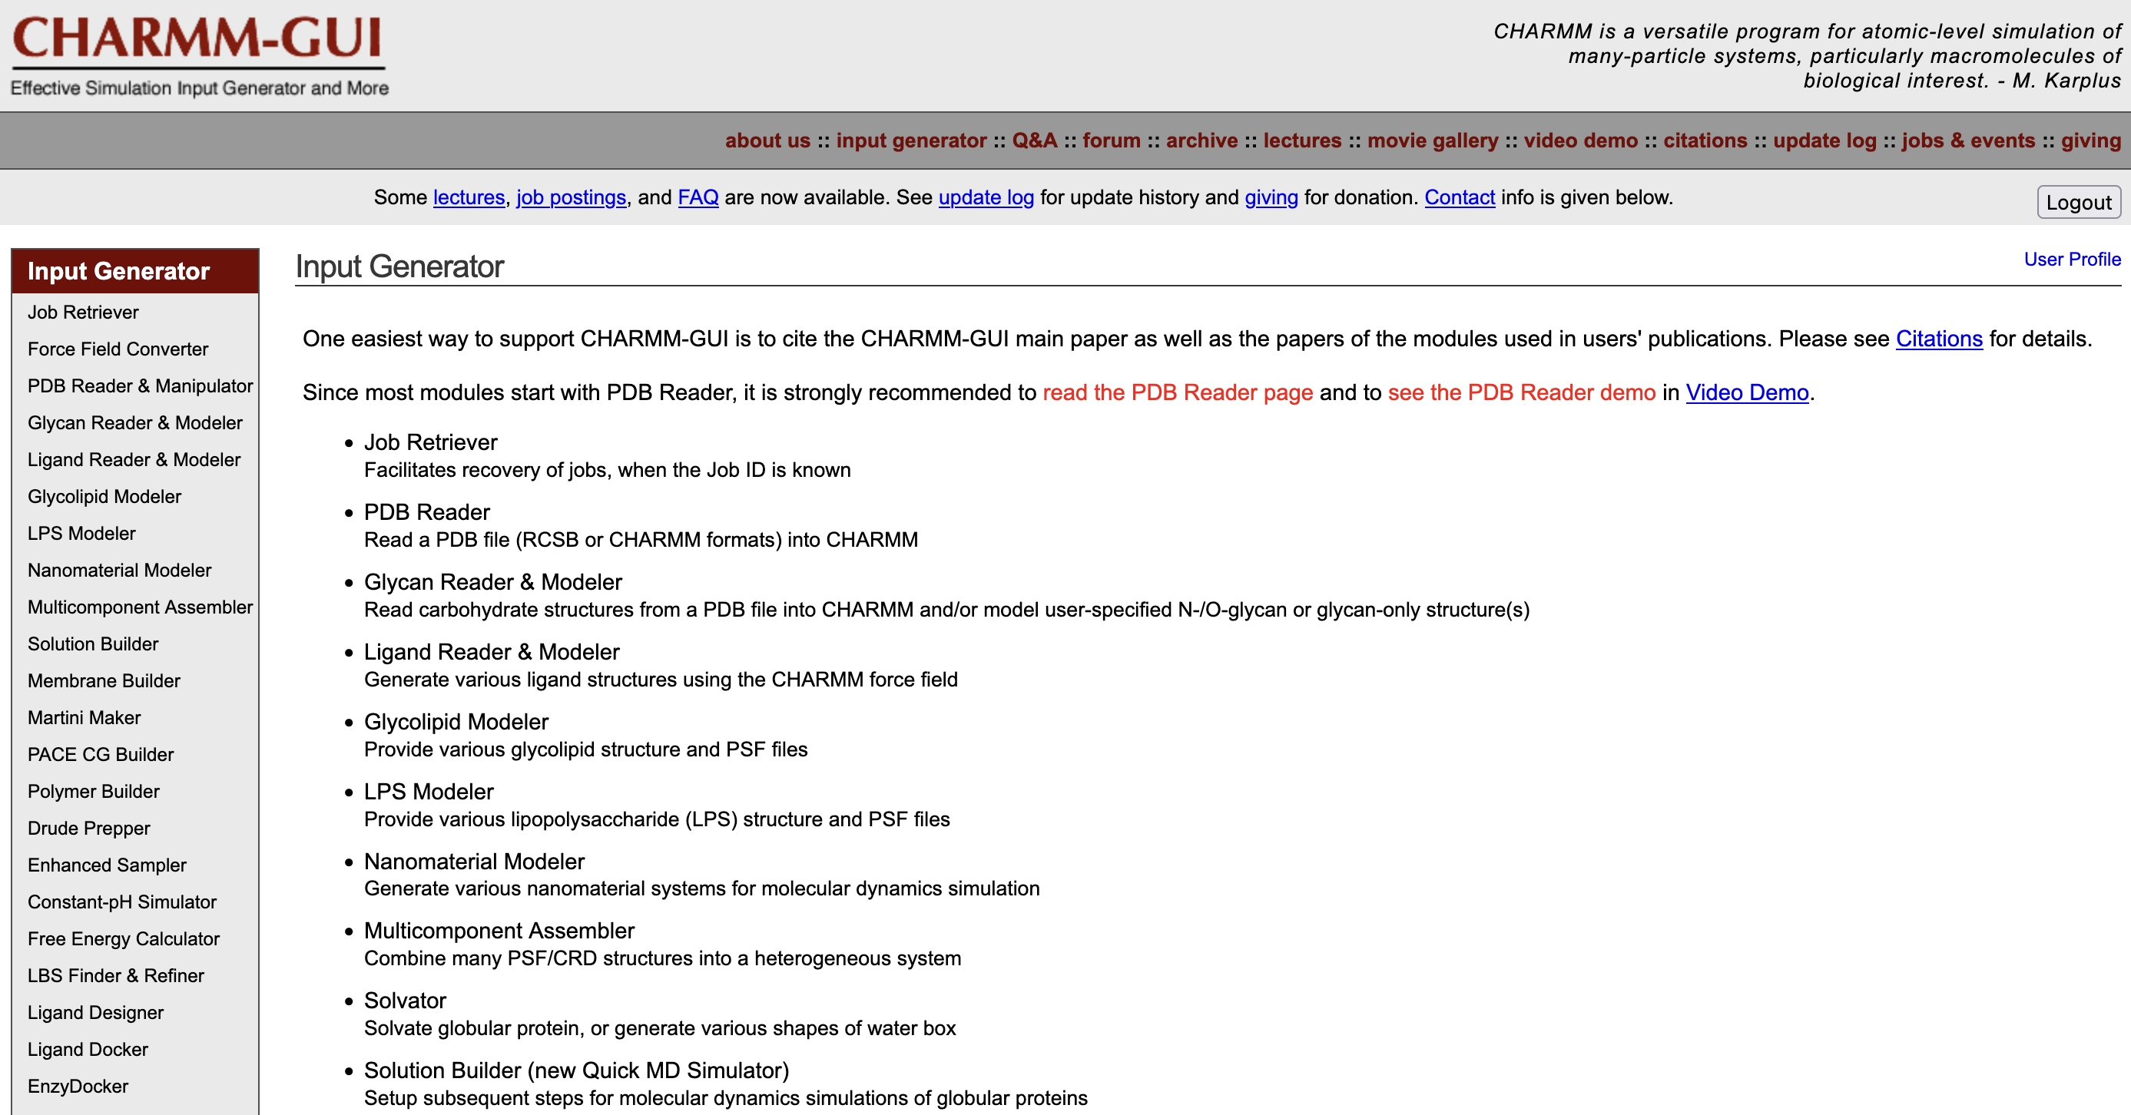
Input files preparation
CHARMM-GUI has many input generator options (we invite you to take a look in all of them later 😁).

Slide 8
Input files preparation
CHARMM-GUI has many input generator options (we invite you to take a look in all of them later 😁).
For our purposes, we are going to use the “Solution Builder” option, which helps the user to build a solvated system for their molecular dynamics simulations.

Slide 9
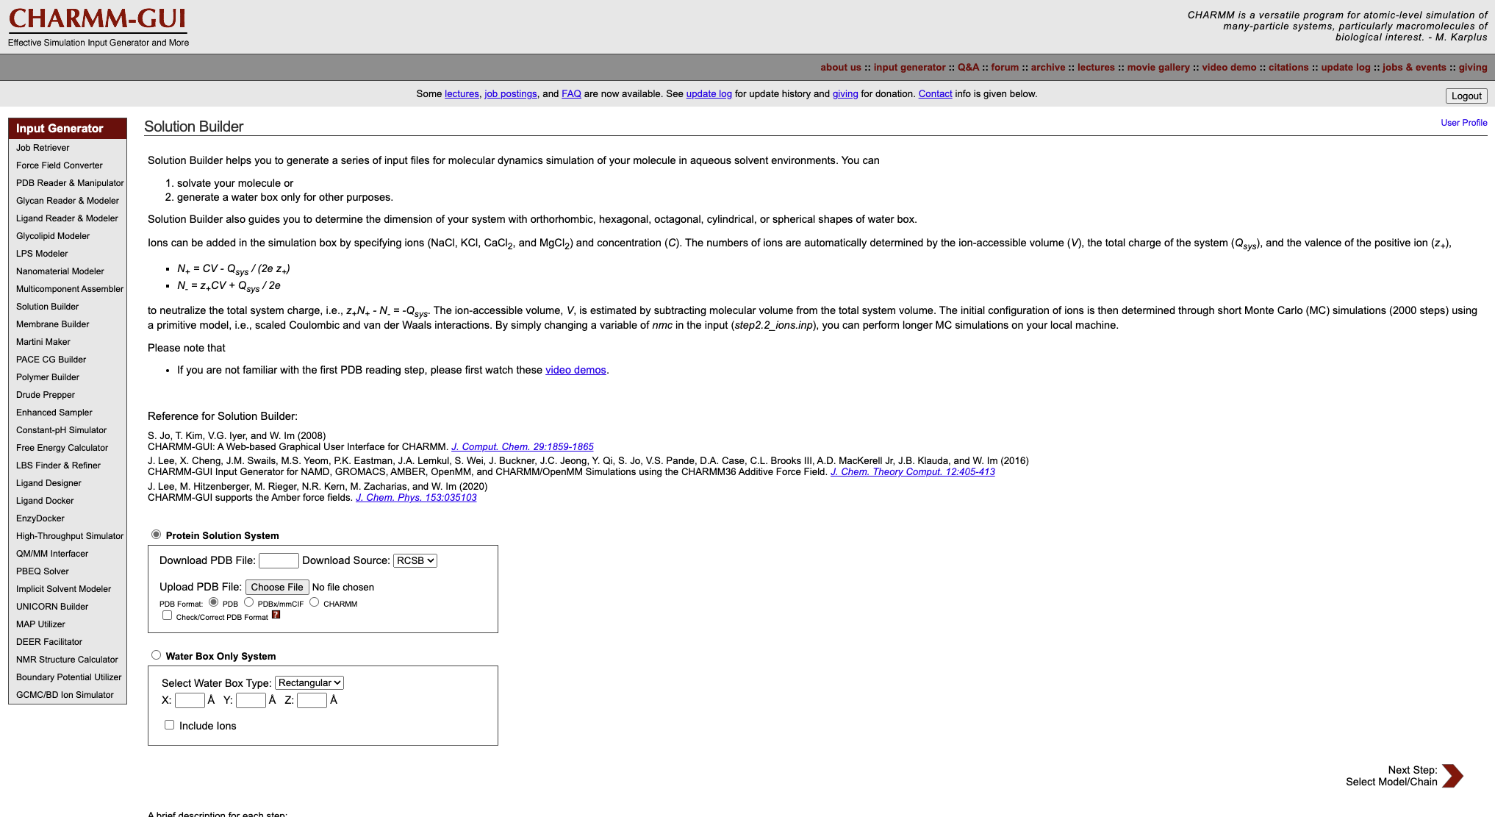
Input files preparation
Select the structure file (.pdb or .cif) of the best-ranked docking protein-ligand complex output, ensure the appropriate file format box is checked, and then click on “Next Step”.

Slide 10
Input files preparation
Alternatively, if you were using an experimentally obtained protein structures, you could retrieve them directly from a database, e.g. RCSB PDB, by inputting the corresponding ID.

Slide 11
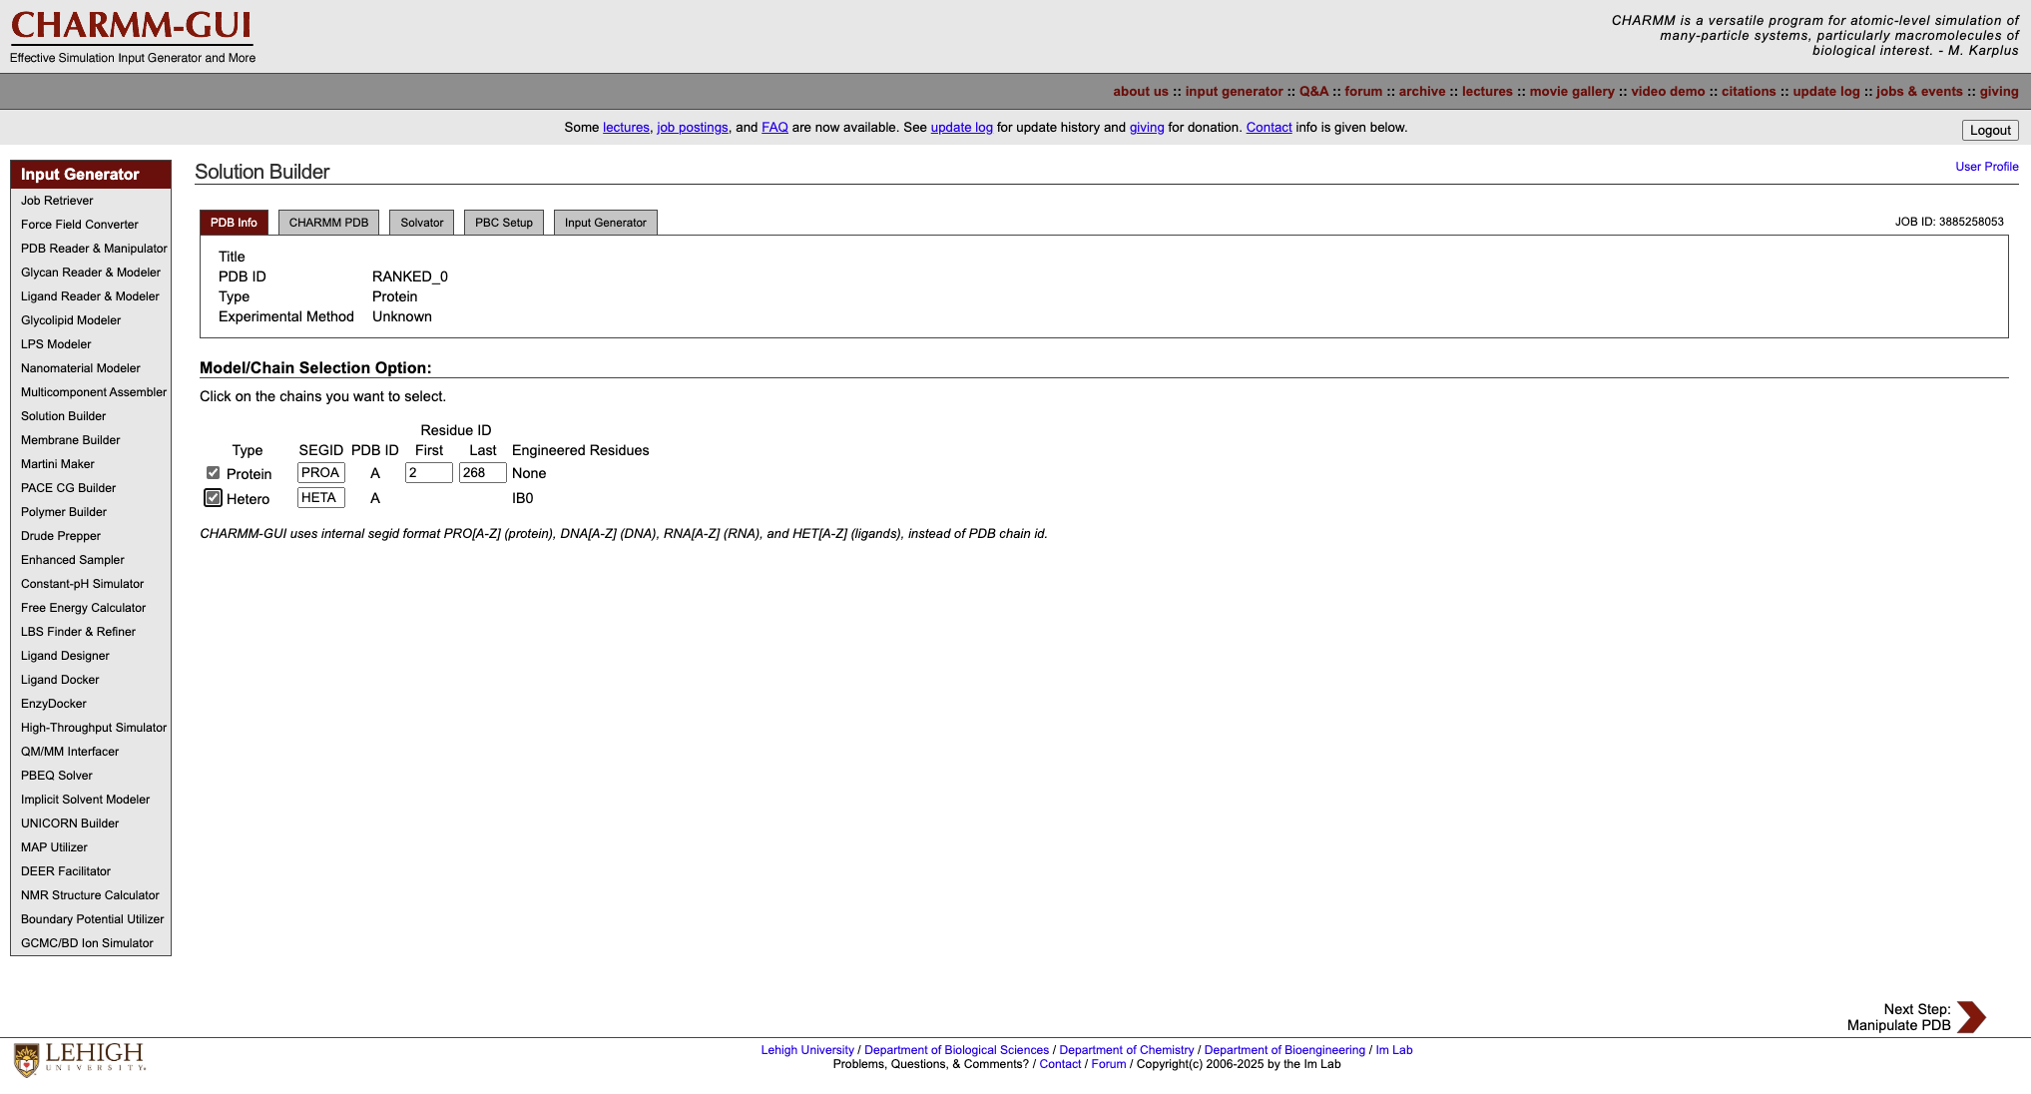
Input files preparation
After uploading your structures, the portal will generate a JOB ID for your current work. Be sure to save it in case you log out before finishing or need to retrieve information about the job.

Slide 12
Input files preparation
If you don’t save your JOB ID, you can recover it on the “User Profile” page.

Slide 13
Input files preparation
Keep in mind that CHARMM-GUI stores jobs for only 7 days. After that, you will need to restart the process.

Slide 14
Input files preparation
Verify if the information regarding your system is correct and do not forget to check both the protein (type: Protein) and the ligand (type: Hetero) boxes.
Click on “Next Step”.

Slide 15
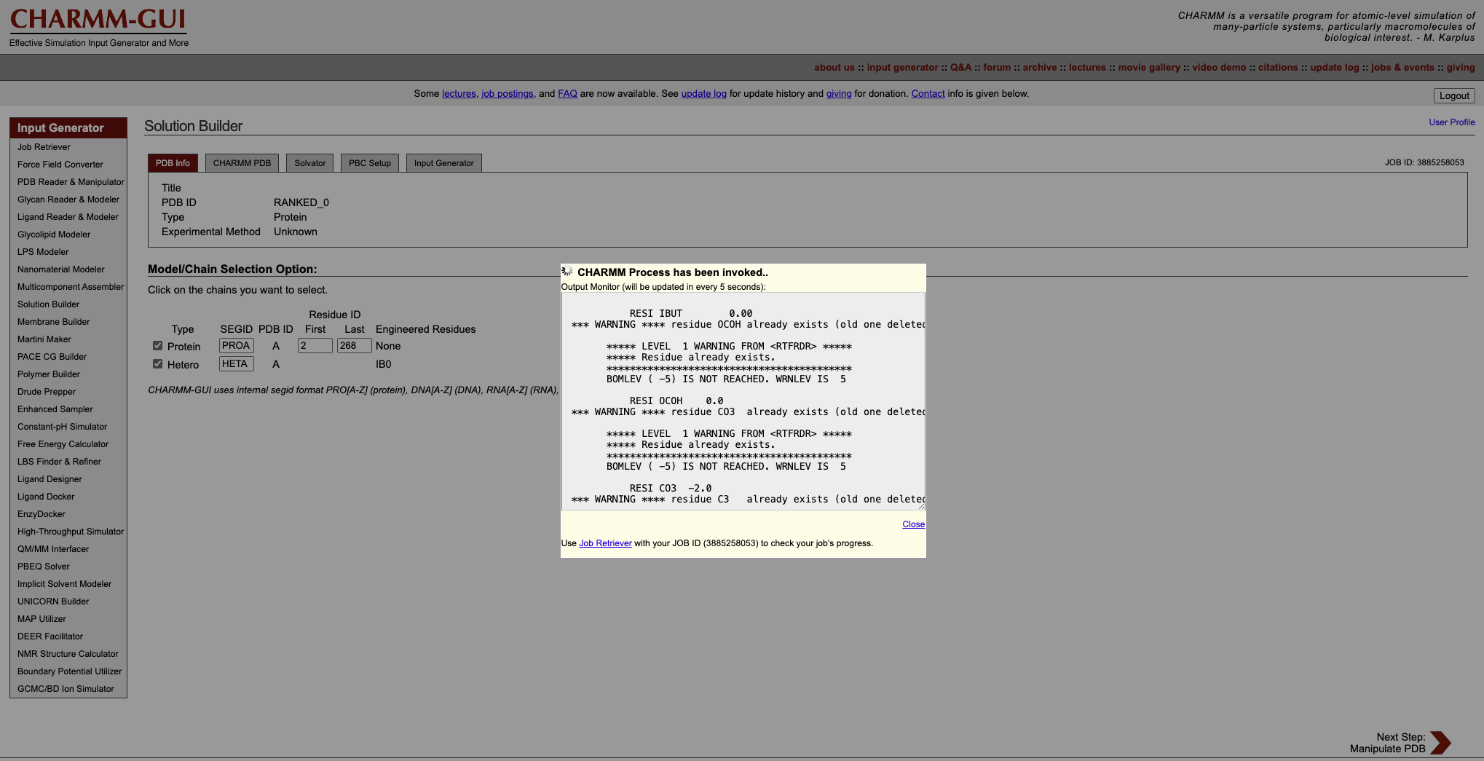
Input files preparation
A processing box will appear every time you hit the “Next Step” button. It will show the progress you of your job, updating it every 5 seconds.

Slide 16
Input files preparation
A processing box will appear every time you hit the “Next Step” button. It will show the progress you of your job, updating it every 5 seconds.
You can choose not to see it by hitting “Close”

Slide 17
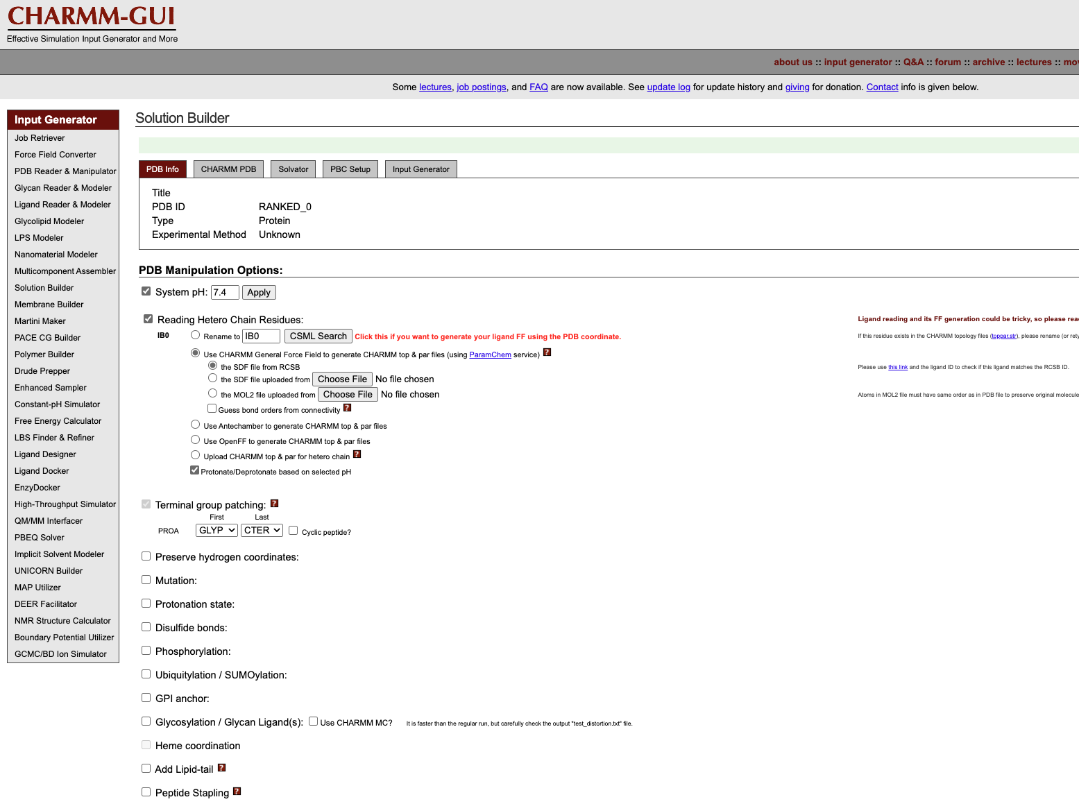
Input files preparation
In this step, you can customize several parameters for your systems. We will recap part of them in our tomorrow’s meeting, but you can find most of them in the CHARMM-GUI’s Q&A, forum, lectures, and video demo sections, at the top left corner of the page.
The pH you expect your system to be should be set at this point.

Slide 18
Input files preparation
In this step, you can customize several parameters for your systems. We will recap part of them in our tomorrow’s meeting, but you can find most of them in the CHARMM-GUI’s Q&A, forum, lectures, and video demo sections, at the top left corner of the page.
You should set the pH of your system according to the conditions you want to simulate. For our purpose here, we will follow DockThor previous assumption and set it to 7.4. Click on “Apply” to change to the new value.

Slide 19
Input files preparation
In this step, you can customize several parameters for your systems. We will recap part of them in our tomorrow’s meeting, but you can find most of them in the CHARMM-GUI’s Q&A, forum, lectures, and video demo sections, at the top left corner of the page.
You should set the pH of your system according to the conditions you want to simulate. For our purpose here, we will follow DockThor previous assumption and set it to 7.4. Click on “Apply” to change to the new value.
Since the ligand you intend to use may not already be available in one of the databases CHARMM-GUI can access, it is better to generate the parameters from the file you initially uploaded, using its .pdb coordinates.
Click on “CSML Search” button.

Slide 20
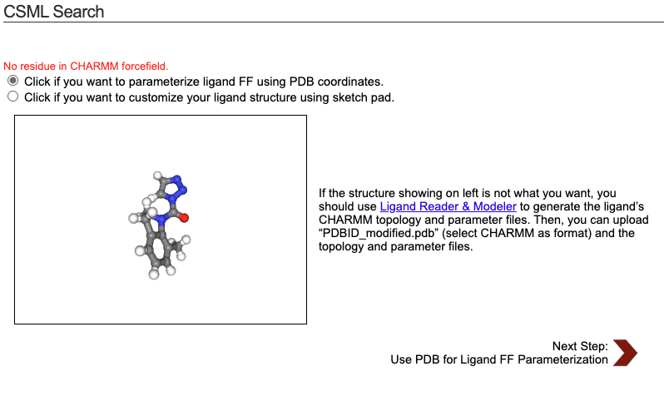
Input files preparation
In this step, you can customize several parameters for your systems. We will recap part of them in our tomorrow’s meeting, but you can find most of them in the CHARMM-GUI’s Q&A, forum, lectures, and video demo sections, at the top left corner of the page.
You should set the pH of your system according to the conditions you want to simulate. For our purpose here, we will follow DockThor previous assumption and set it to 7.4. Click on “Apply” to change to the new value.
This will pop the CSML Search window, in which you should select “parameterize using PDB coordinates”, and hit “Next Step”.
Since the ligand you intend to use may not already be available in one of the databases CHARMM-GUI can access, it is better to generate the parameters from the file you initially uploaded, using its .pdb coordinates.
Click on “CSML Search” button.

Slide 21
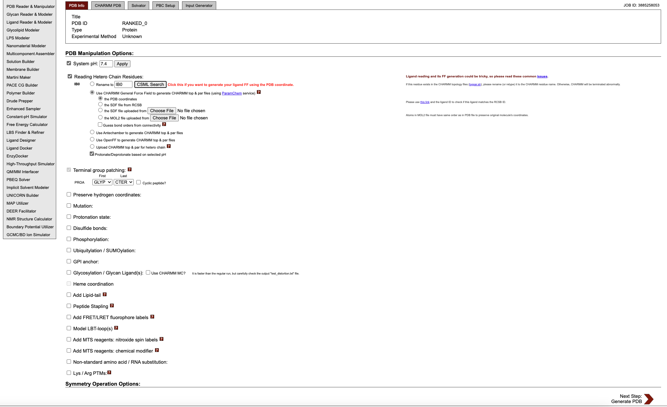
Input files preparation
Note that it was automatically changed to “the PDB coordinates”

Slide 22
Input files preparation
Note that it was automatically changed to “the PDB coordinates”
Check if this box is already enabled. By selecting it, the platform will take care of the protonation of your system based on the set pH.

Slide 23
Input files preparation
Note that it was automatically changed to “the PDB coordinates”
Check if this box is already enabled. By selecting it, the platform will take care of the protonation of your system based on the set pH.
Alternatively, you can customize the protonation states of the amino acids to suit your specific intentions.

Slide 24
Input files preparation
Note that it was automatically changed to “the PDB coordinates”
Check if this box is already enabled. By selecting it, the platform will take care of the protonation of your system based on the set pH.
Alternatively, you can customize the protonation states of the amino acids to suit your specific intentions.
CHARMM-GUI automatically defines the termini group patching to ensure they are properly represented in the simulation, but you can customize it if needed.

Slide 25
Input files preparation
Note that it was automatically changed to “the PDB coordinates”
Check if this box is already enabled. By selecting it, the platform will take care of the protonation of your system based on the set pH.
Alternatively, you can customize the protonation states of the amino acids to suit your specific intentions.
CHARMM-GUI automatically defines the termini group patching to ensure they are properly represented in the simulation, but you can customize it if needed.
You can also perform mutations, add post-translational, and a whole set of customization for your system if it needs.

Slide 26
Input files preparation
Note that it was automatically changed to “the PDB coordinates”
Check if this box is already enabled. By selecting it, the platform will take care of the protonation of your system based on the set pH.
For the purpose of our tutorial, we will change only the parameters we mentioned before.
Click on “Next Step” to proceed.
Alternatively, you can customize the protonation states of the amino acids to suit your specific intentions.
CHARMM-GUI automatically defines the termini group patching to ensure they are properly represented in the simulation, but you can customize it if needed.

Slide 27
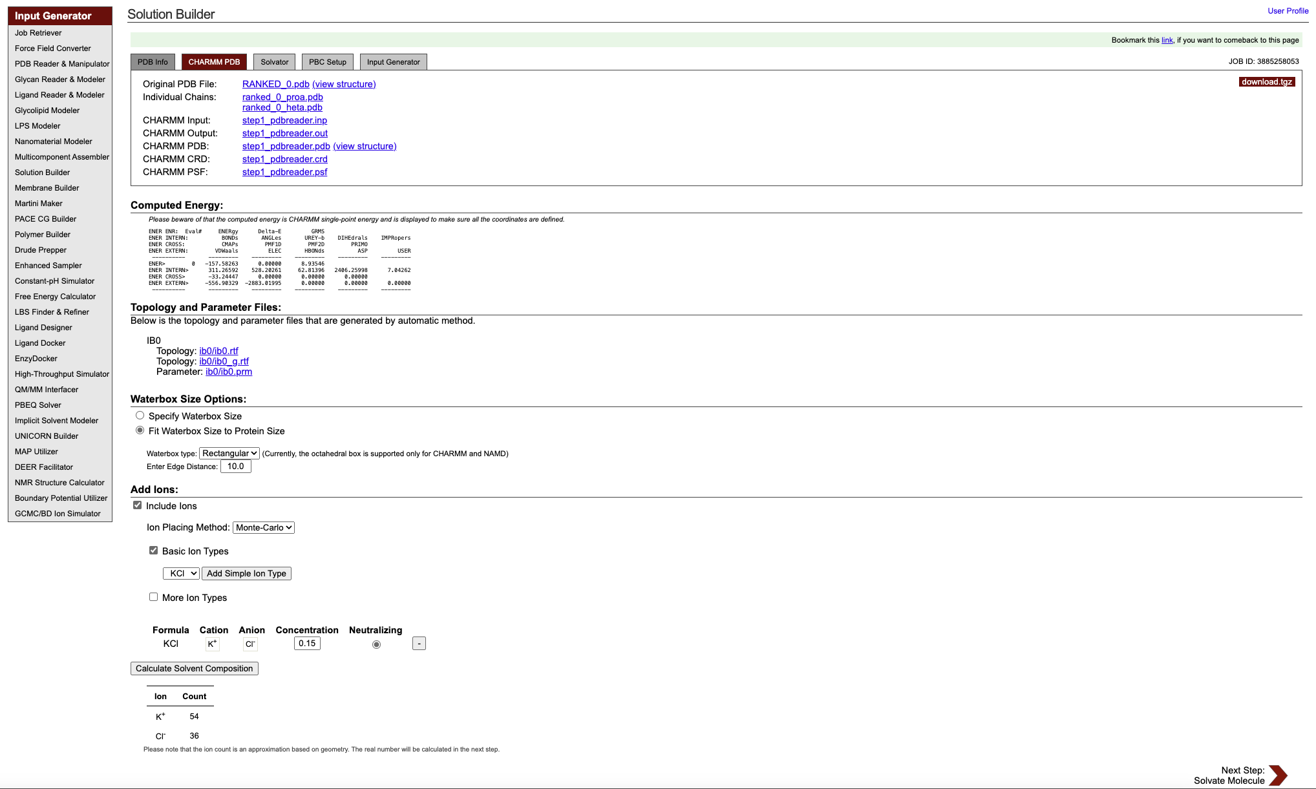
Input files preparation
In this step you will be able to set the water box size and shape, and add ions to your system.

Slide 28
Input files preparation
You can visually inspect the uploaded and initially processed structures by clicking on “view structure.” It will pop up another window for your visualization.

Slide 29
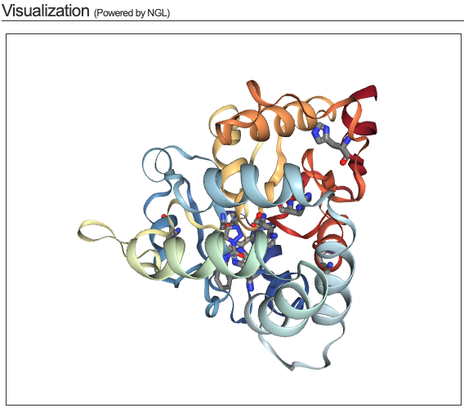
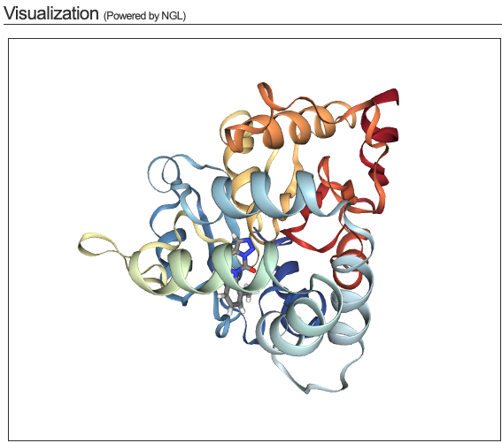
Input files preparation

Slide 30
Input files preparation
You can also download the files generated so far if you wish to inspect them.
(You will need to download them at the final step, so you may choose to wait until then.)

Slide 31
Input files preparation
Here you can see a breakdown of the energy components for a molecular system, calculated as a single-point energy using the CHARMM force field.
This is a static calculation of the system's energy without any dynamics or minimization. It is mainly used to ensure that all coordinates are well-defined and that the structure is suitable for further simulations.

Slide 32
Input files preparation
Here you can see the generated topology (.rtf) and parameter (.prm) files CHARMM-GUI will use to help preparing your system.*
Topology files contain information about the molecular structure, including atom types, bonding patterns, charges, and connectivity.
* Short definitions
Parameter files specify the energy functions and associated parameters (e.g., bond lengths, angles, dihedrals, van der Waals interactions, and electrostatics) used in the force field for energy calculations.

Slide 33
Input files preparation
You can choose the shape of the water box, either rectangular or octahedral, and set the distance between your complex and the edges of the box.

Slide 34
Input files preparation
Finally, you can set ion content for your system to ensure it behaves as closely as possible to the natural biological environment, making the simulation results more reliable and meaningful.
You can choose different ion types and concentrations.
Also, if you change the previous values, you have to recalculate the solvent composition.

Slide 35
Input files preparation
We suggest here to keep the portal’s default parameters, but you are free to choose your own.
After setting it, click on “Next Step” to proceed.
(This step may take some minutes to complete)

Slide 36
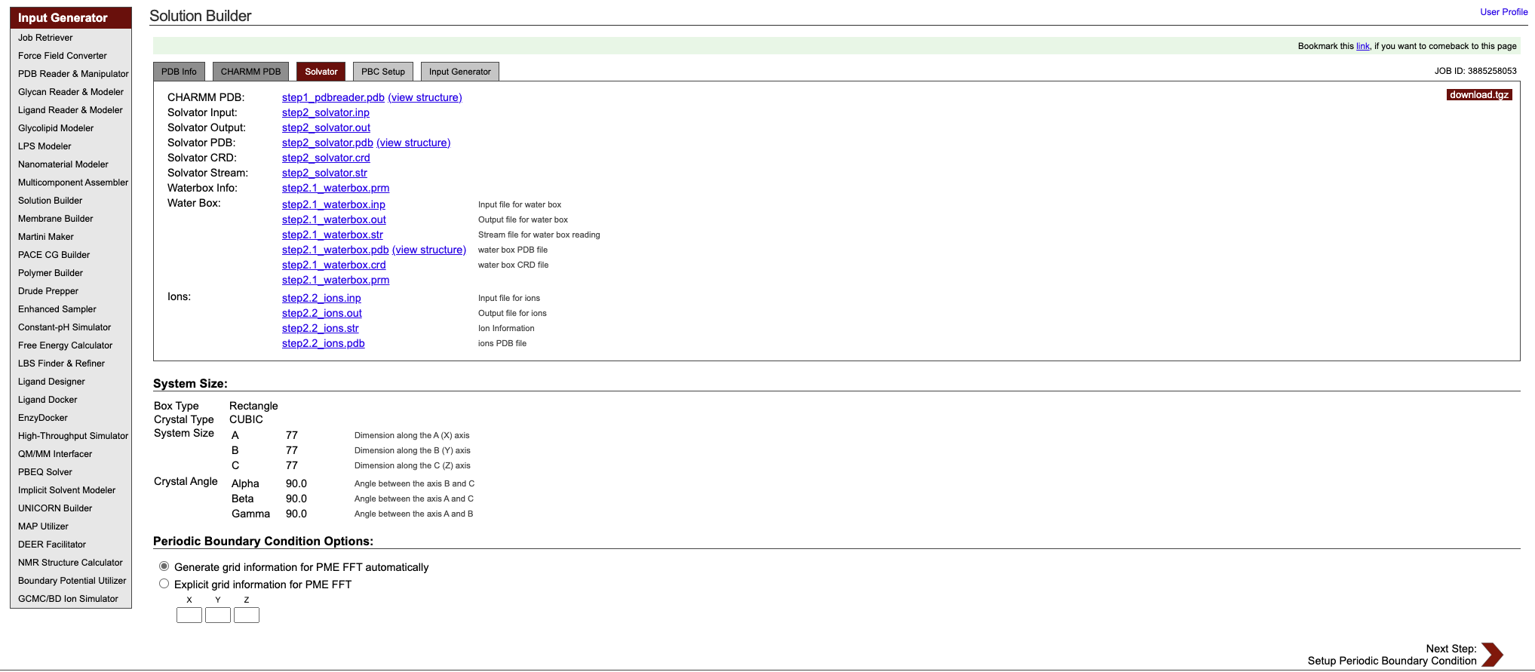
Input files preparation
We have now created the water box and the ion files, which can be checked by clicking on each of them in the list.

Slide 37
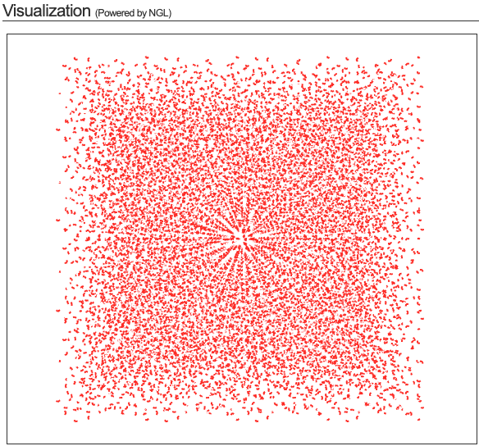
Input files preparation

Slide 38
Input files preparation
In this field you can verify your system’s features, which were set in the previous steps. This defines the unit cell* of your system.

Slide 39
Input files preparation
Here you can set the periodic boundary conditions (PBC)* for your system.
We recommend you to let CHARMM-GUI set it automatically to avoid errors in specifying grid dimensions manually.

Slide 40
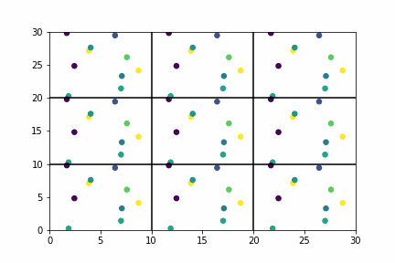

Input files preparation
The unit cell is the smallest periodic volume that contains all the atoms, molecules, and/or ions in the simulation box.
The dimensions of the unit cell are defined by the lengths of the box sides (a, b, c) and the angles between them (α, β, γ).
Unit cell
PBCs
Periodic boundary conditions (PBC) are used in simulations to mimic an infinite system by repeating the unit cell infinitely in all directions. When an atom moves out of the unit cell, it re-enters from the opposite side, creating the illusion of an endless, unbounded system.
This setup helps simulate bulk properties without having to model an entire infinite system.
* Short definitions
Made by Cameron Mcelfresh

Slide 41
Input files preparation
Click on “Next Step” to proceed and generate solvated system.

Slide 42
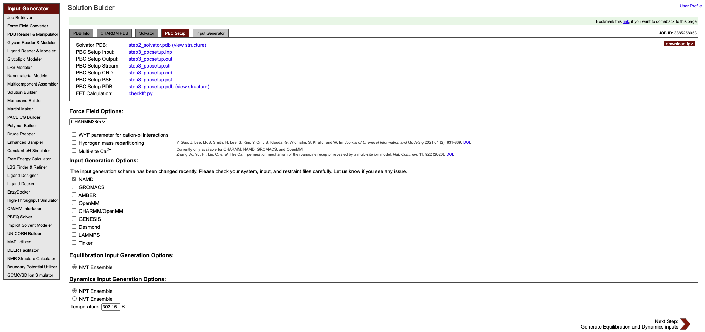
Input files preparation
In the last step you can check your solvated system before generating the equilibration and dynamics inputs.

Slide 43
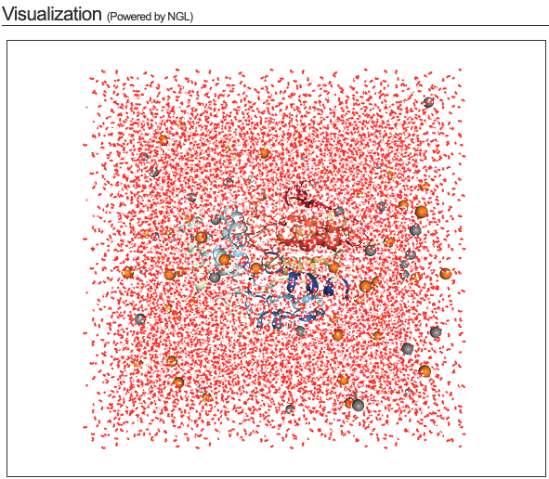
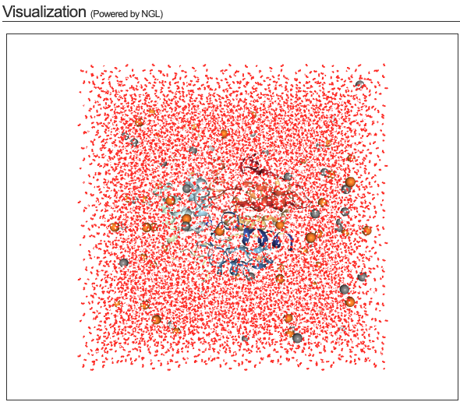
Input files preparation
Solvated system
PBCs applied to solvated system

Slide 44
Input files preparation
You can choose one of the available force field options:
CHARMM36m
CHARMM36
AMBER
OPLS-AA/M
We suggest going with CHARMM36m.

Slide 45
Input files preparation
WYF parameter for cation-pi interactions enables specific parameters for cation-π interactions involving aromatic residues like tryptophan (W), tyrosine (Y), and phenylalanine (F);
Hydrogen Mass Repartitioning modifies the mass of hydrogen atoms by redistributing mass from heavy atoms (e.g., carbon, nitrogen) to their bonded hydrogens;
Multi-Site Ca²⁺ resents a specialized model for calcium ions (Ca²⁺) using an approach, where the ion's charge is distributed over multiple sites to better capture its interactions.

Slide 46
Input files preparation
WYF parameter for cation-pi interactions enables specific parameters for cation-π interactions involving aromatic residues like tryptophan (W), tyrosine (Y), and phenylalanine (F);
Hydrogen Mass Repartitioning modifies the mass of hydrogen atoms by redistributing mass from heavy atoms (e.g., carbon, nitrogen) to their bonded hydrogens;
Multi-Site Ca²⁺ resents a specialized model for calcium ions (Ca²⁺) using an approach, where the ion's charge is distributed over multiple sites to better capture its interactions.
We suggest you to proceed without selecting them.

Slide 47
Input files preparation
We are going to use NAMD as our software to run our molecular dynamics simulations, but CHARMM-GUI offers a bunch of different options.

Slide 48
Input files preparation
For equilibration inputs, you have to go with NVT ensemble*, but for the dynamics you can choose between NVT and NPT ensembles*.
You can also set the temperature, in Kelvin, you want your simulation to be performed.

Slide 49
Input files preparation
Roughly speaking, an ensemble is a group of many possible states of a system, used to study its behaviour.
NVT stands for Number of particles (N), Volume (V), and Temperature (T). In this simulation, these three stay constant. It mimics a system where the container size is fixed, and temperature is controlled.
* Short definitions
NPT stands for Number of particles (N), Pressure (P), and Temperature (T). In this simulation, pressure and temperature are controlled, while the system can change size. It is like a system in an adjustable container that keeps the pressure steady.

Slide 50
Input files preparation
Click on “Next Step” for generating the final input files.

Slide 51
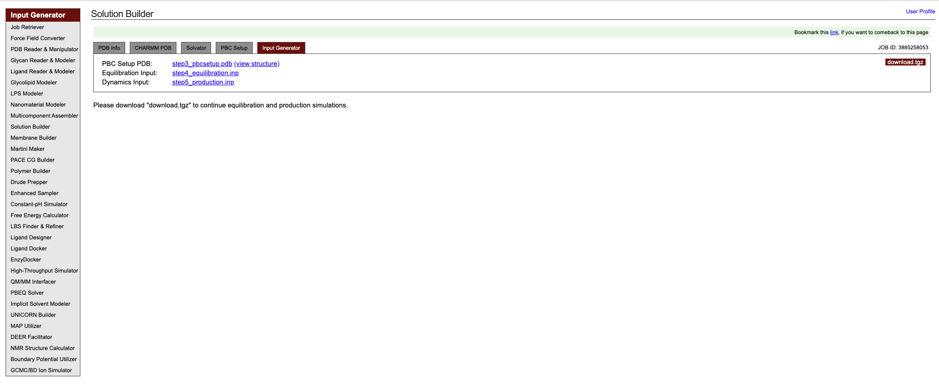
Input files preparation
Now we are ready to proceed with our molecular dynamics simulations. Simply download the input files by clicking the “download.tgz” button.

Slide 52
CHARMM-GUI files
Once you download it, you will get a compressed file (.tgz). Uncompress it to get access to the files containing all the files CHARMM-GUI generated.

Slide 53
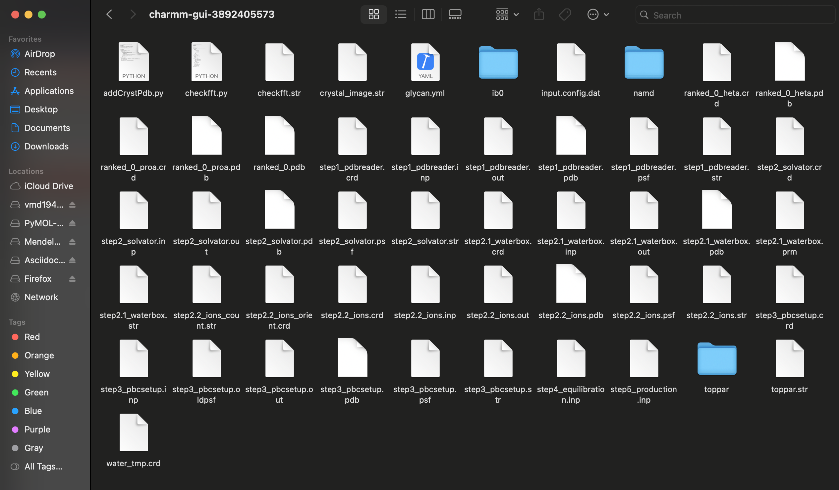
CHARMM-GUI files
Once you download it, you will get a compressed file (.tgz). Uncompress it to get access to the files containing all the files CHARMM-GUI generated.
We will need the ligand folder (ib0, in this image, but it will be named according to the name the ligand has in the input pdb file), the “namd” folder, and the “step3_pbcsetup.str”.

Slide 54
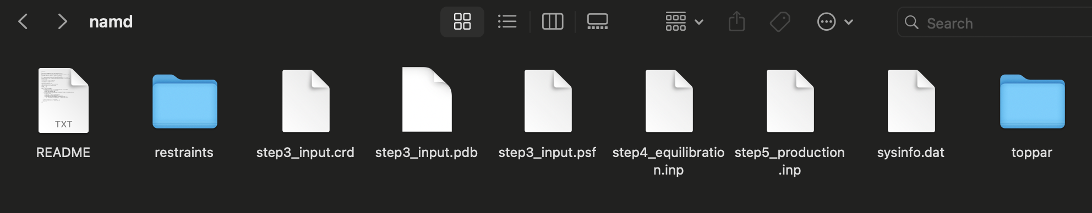
NAMD folder
The README file contains instructions of how to run your MD simulation using NAMD simulation. For our tutorial, we are going to use the one available on the workshop folder (protein_md.sbatch).

Slide 55
NAMD folder
The README file contains instructions of how to run your MD simulation using NAMD simulation. For our tutorial, we are going to use the one available on the workshop folder (protein_md.sbatch).
This folder contains a .ref file within it, with information on atomic positions or groups of atoms to which certain constraints or restraints are applied. It includes data for position restraints (where the atoms are kept at specific positions during the simulation) or bonding restraints (restraining the flexibility of certain bonds).

Slide 56
NAMD folder
The README file contains instructions of how to run your MD simulation using NAMD simulation. For our tutorial, we are going to use the one available on the workshop folder (protein_md.sbatch).
This folder contains a .ref file within it, with information on atomic positions or groups of atoms to which certain constraints or restraints are applied. It includes data for position restraints (where the atoms are kept at specific positions during the simulation) or bonding restraints (restraining the flexibility of certain bonds).
This file contains the coordinates of the atoms in your system at a given point in the simulation or from the initial setup.

Slide 57
NAMD folder
The README file contains instructions of how to run your MD simulation using NAMD simulation. For our tutorial, we are going to use the one available on the workshop folder (protein_md.sbatch).
The .psf (protein structure file) contains topological information about the system, such as the types of atoms; bonds, angles, dihedrals, and improper torsions; Masses, charges, and atom types. It is used by NAMD to interpret the system's molecular structure in a way that the software can apply the force field parameters correctly.
This folder contains a .ref file within it, with information on atomic positions or groups of atoms to which certain constraints or restraints are applied. It includes data for position restraints (where the atoms are kept at specific positions during the simulation) or bonding restraints (restraining the flexibility of certain bonds).
This file contains the coordinates of the atoms in your system at a given point in the simulation or from the initial setup.

Slide 58
NAMD folder
The README file contains instructions of how to run your MD simulation using NAMD simulation. For our tutorial, we are going to use the one available on the workshop folder (protein_md.sbatch).
The .psf (protein structure file) contains topological information about the system, such as the types of atoms; bonds, angles, dihedrals, and improper torsions; Masses, charges, and atom types. It is used by NAMD to interpret the system's molecular structure in a way that the software can apply the force field parameters correctly.
This folder contains a .ref file within it, with information on atomic positions or groups of atoms to which certain constraints or restraints are applied. It includes data for position restraints (where the atoms are kept at specific positions during the simulation) or bonding restraints (restraining the flexibility of certain bonds).
It contains the topology and parameter (.prm and .str) files that define how atoms interact in the system according to the chosen force field. It holds the data that describes the chemical environment of the system and the potential energy functions that will be used during the MD simulation.
This file contains the coordinates of the atoms in your system at a given point in the simulation or from the initial setup.

Slide 59
NAMD folder
The README file contains instructions of how to run your MD simulation using NAMD simulation. For our tutorial, we are going to use the one available on the workshop folder (protein_md.sbatch).
The .psf (protein structure file) contains topological information about the system, such as the types of atoms; bonds, angles, dihedrals, and improper torsions; Masses, charges, and atom types. It is used by NAMD to interpret the system's molecular structure in a way that the software can apply the force field parameters correctly.
This is the equilibration input file. It contains all the input configuration to perform the simulations to equilibrate the system’s molecules.
This folder contains a .ref file within it, with information on atomic positions or groups of atoms to which certain constraints or restraints are applied. It includes data for position restraints (where the atoms are kept at specific positions during the simulation) or bonding restraints (restraining the flexibility of certain bonds).
It contains the topology and parameter files that define how atoms interact in the system according to the chosen force field. It holds the data that describes the chemical environment of the system and the potential energy functions that will be used during the MD simulation.
This file contains the coordinates of the atoms in your system at a given point in the simulation or from the initial setup.

Slide 60
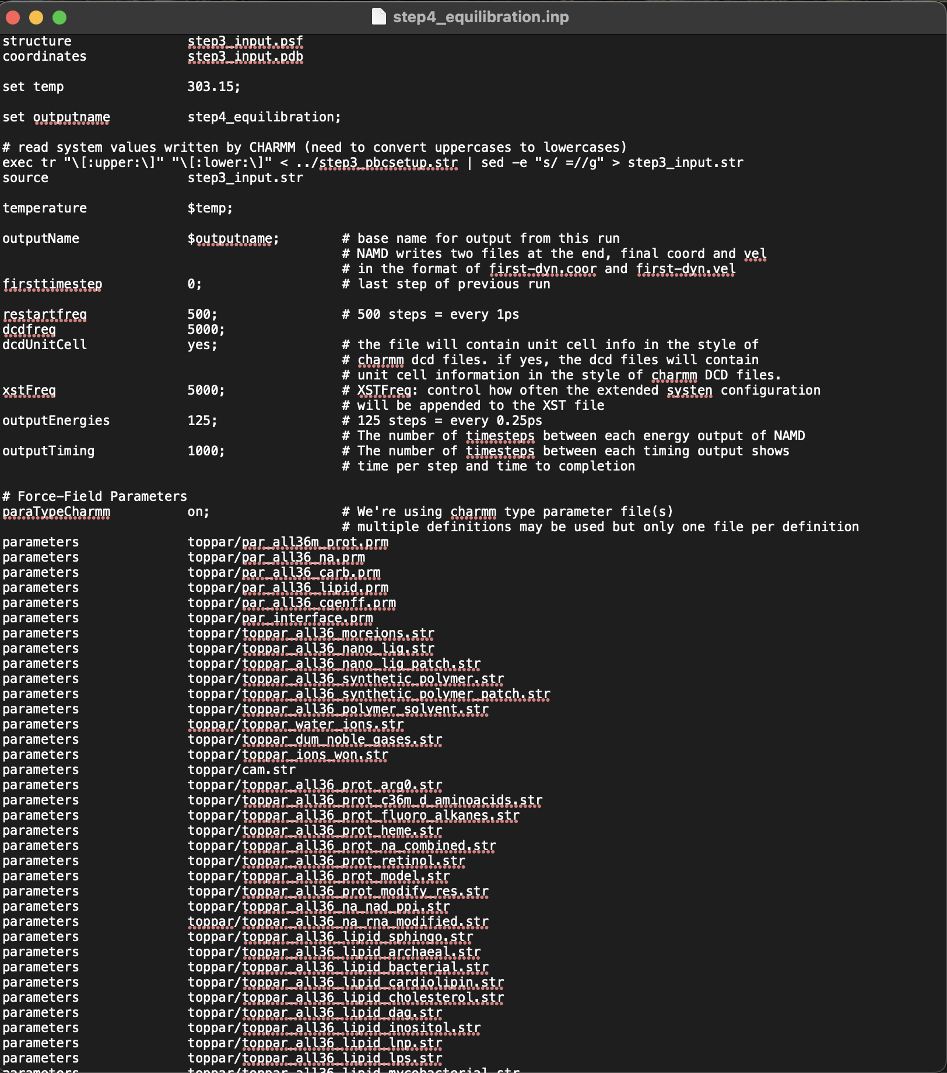
NAMD folder
This is how your equilibration input file should look like. It includes system parameters, temperature settings, and output controls necessary to relax the system while maintaining stability before transitioning to the production phase.

Slide 61
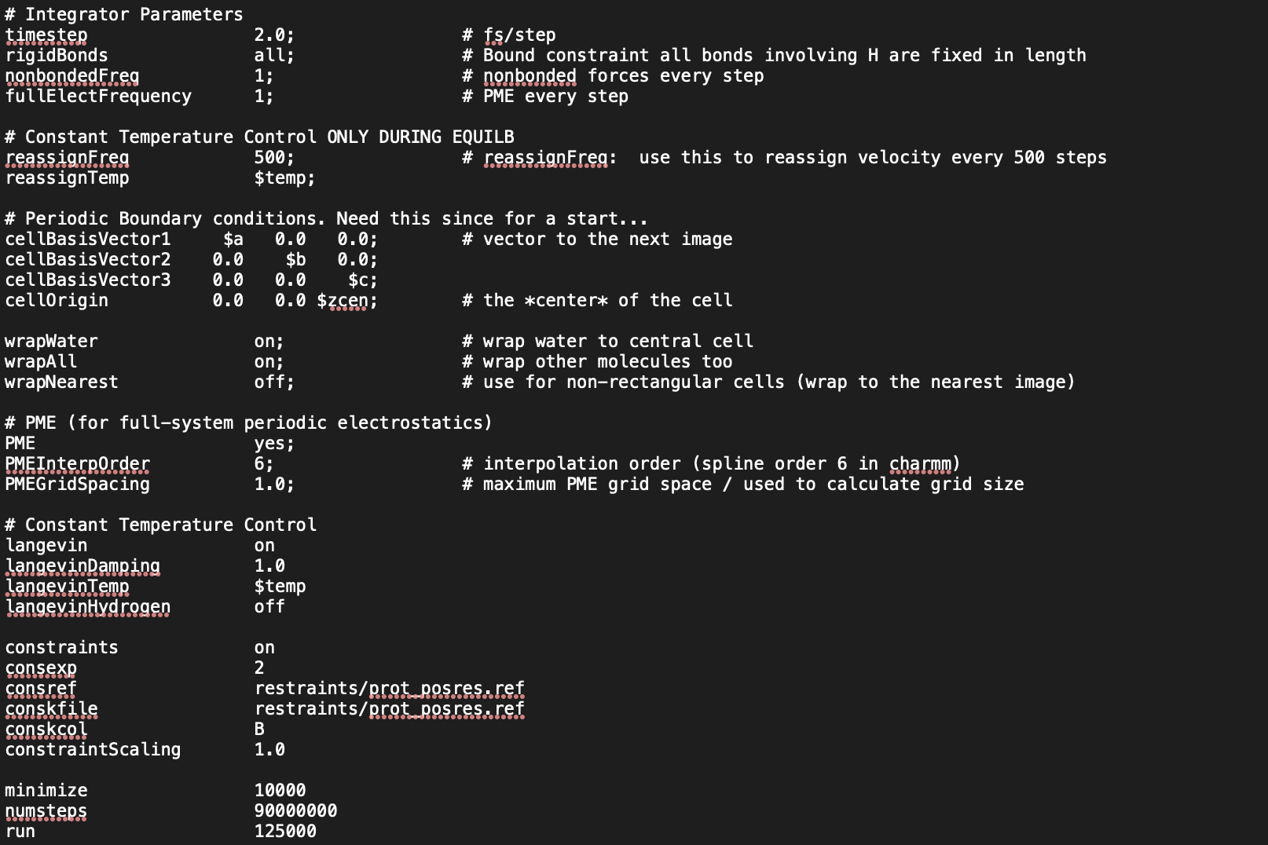
NAMD folder

Slide 62
NAMD folder
You can change the length of your equilibration step by modifying these highlighted parameters.

Slide 63
NAMD folder
The README file contains instructions of how to run your MD simulation using NAMD simulation. For our tutorial, we are going to use the one available on the workshop folder (protein_md.sbatch).
The .psf (protein structure file) contains topological information about the system, such as the types of atoms; bonds, angles, dihedrals, and improper torsions; Masses, charges, and atom types. It is used by NAMD to interpret the system's molecular structure in a way that the software can apply the force field parameters correctly.
This is the production (or dynamics) input file. It contains all the input configuration to perform the “real” MD simulations.
This folder contains a .ref file within it, with information on atomic positions or groups of atoms to which certain constraints or restraints are applied. It includes data for position restraints (where the atoms are kept at specific positions during the simulation) or bonding restraints (restraining the flexibility of certain bonds).
It contains the topology and parameter files that define how atoms interact in the system according to the chosen force field. It holds the data that describes the chemical environment of the system and the potential energy functions that will be used during the MD simulation.
This file contains the coordinates of the atoms in your system at a given point in the simulation or from the initial setup.

Slide 64
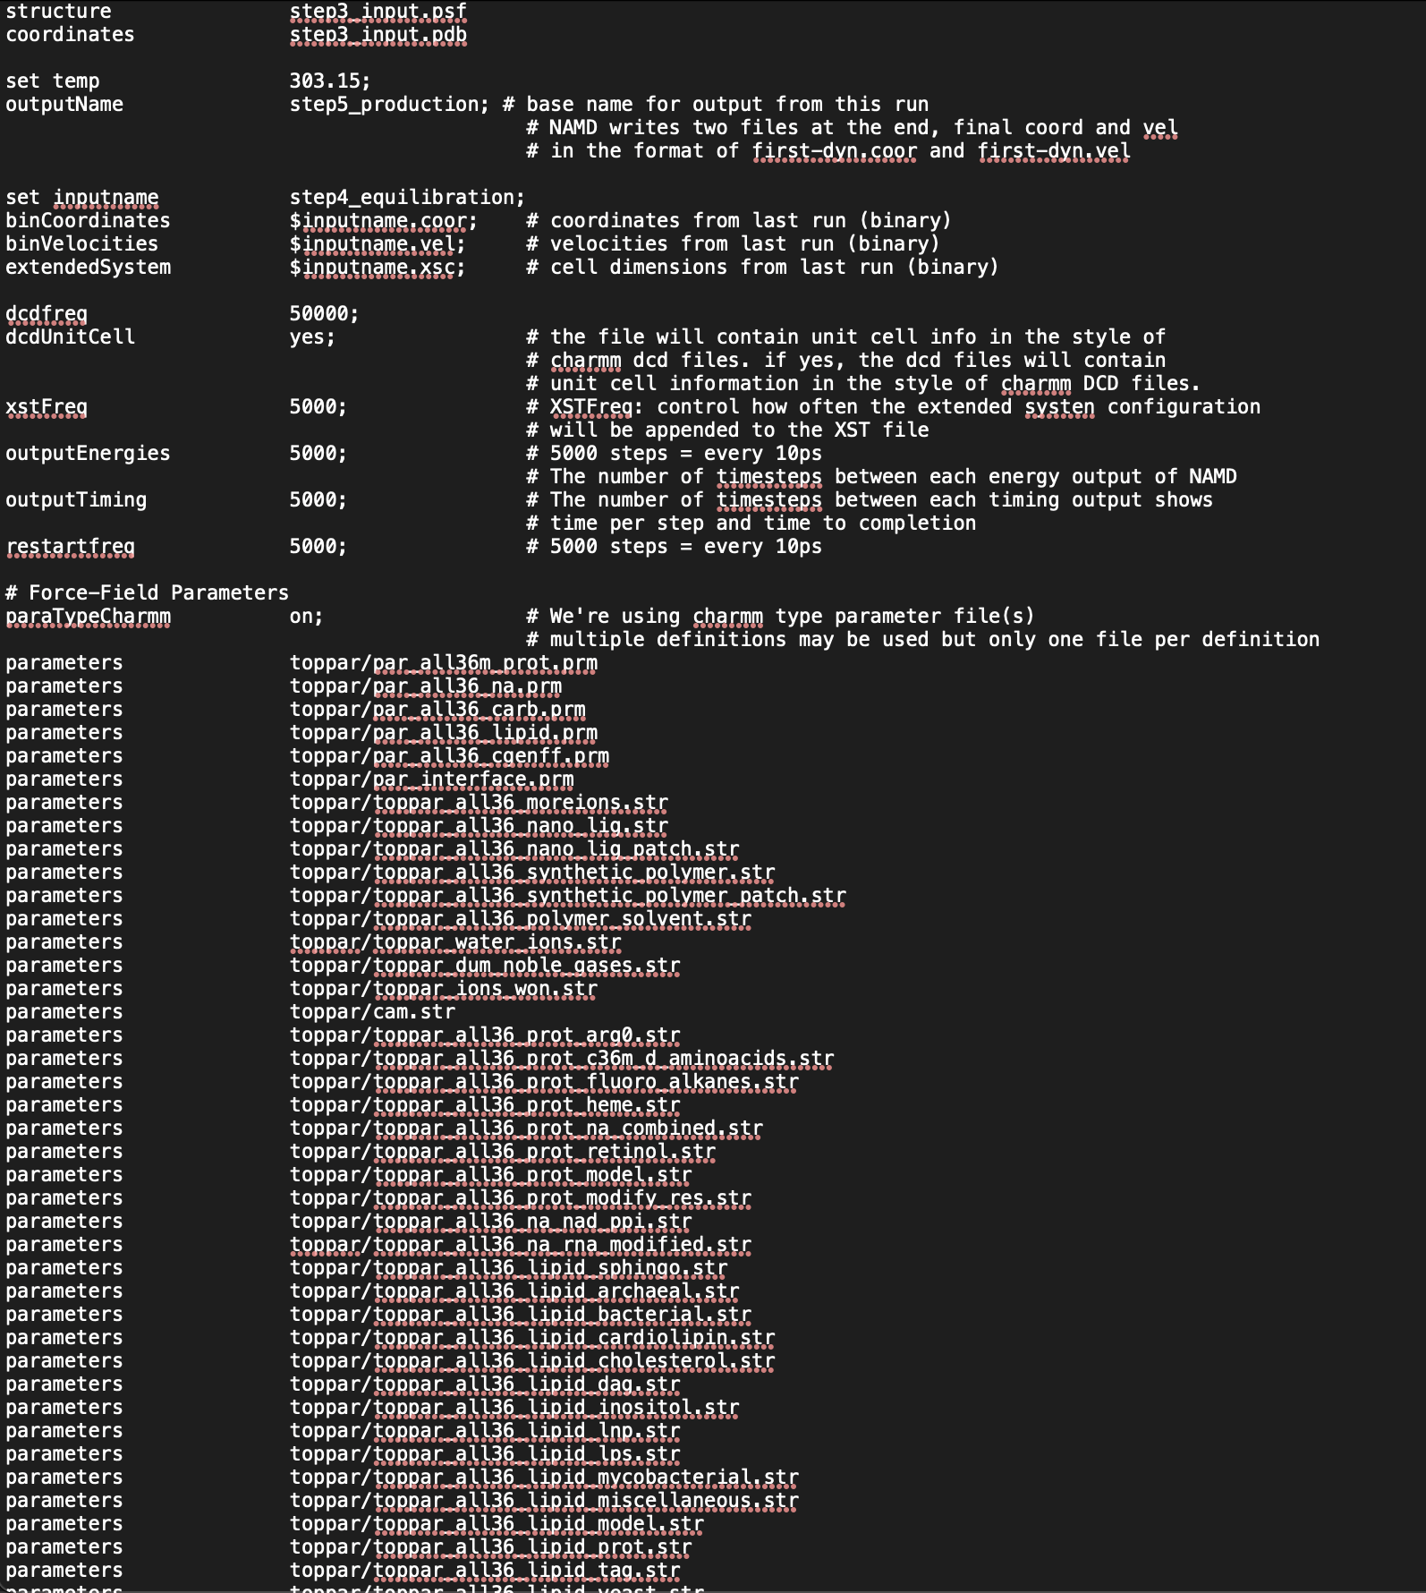
NAMD folder
This is how your production input file should look like. It is used to run the actual molecular dynamics simulation after the equilibration step. It contains all the necessary settings for a longer-lasting simulation.

Slide 65
NAMD folder
This how your production input file should look like. It is used to run the actual molecular dynamics simulation after the equilibration step. It contains all the necessary settings for a longer-lasting simulation.
Most of the parameters are the same as before in equilibration, but here you can also set how frequently the trajectory of your system is saved.

Slide 66
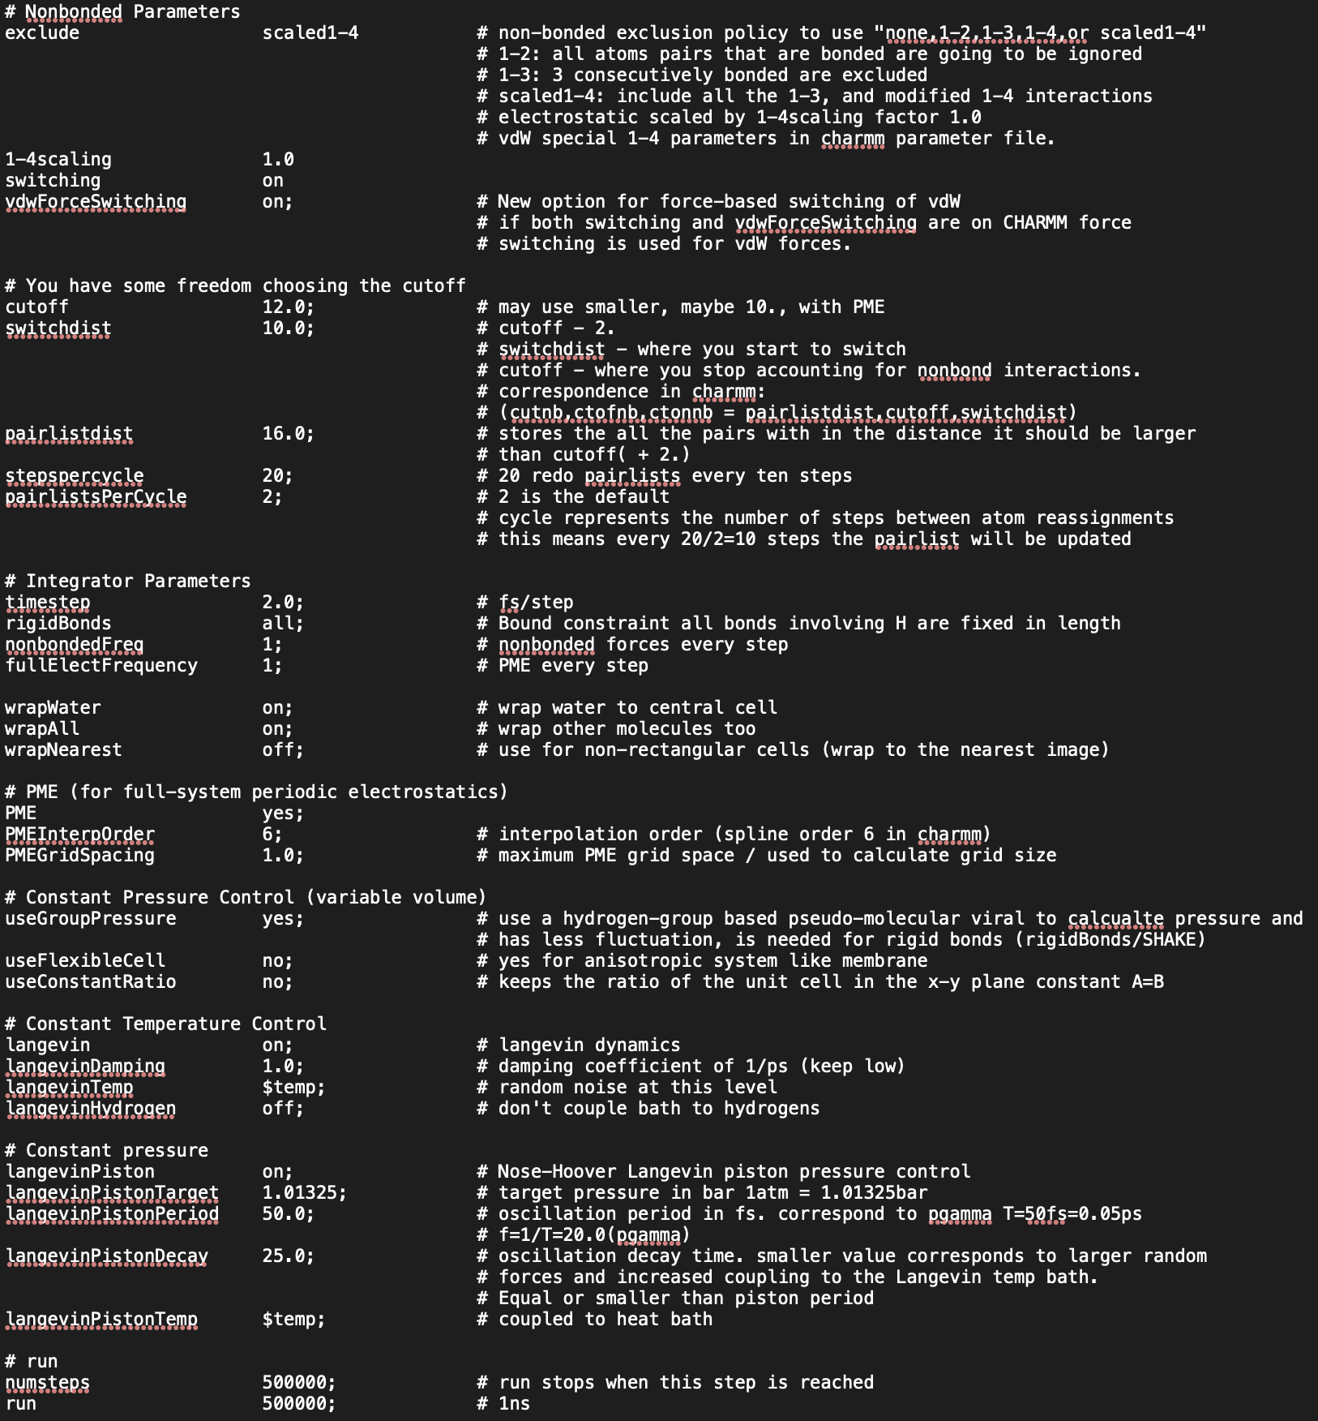
NAMD folder

Slide 67
NAMD folder
The length of your simulation will be defined by this parameters. Keep in mind that 500,000 steps represents 1 ns of MD simulation.

Slide 68
NAMD folder
The length of your simulation will be defined by this parameters. Keep in mind that 500,000 steps represents 1 ns of MD simulation.
For this tutorial, we recommend leaving the parameters as they are, but you may change them if you wish. Please note the total simulation time you set, as server performance may vary depending on demand.

Slide 69
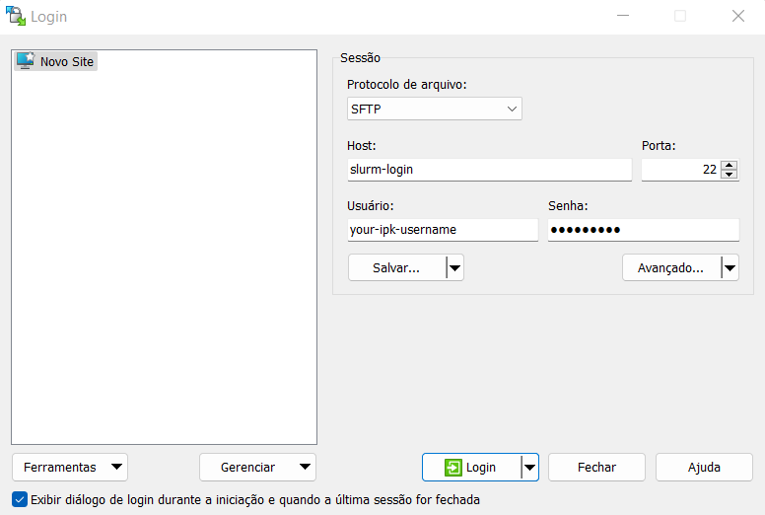
Uploading files to server
We will upload the files you obtained from CHARMM-GUI to the server. First, log in to WinSCP to make this transfer easier.

Slide 70
Uploading files to server
We will upload the files you obtained from CHARMM-GUI to the server. First, log in to WinSCP to make this transfer easier.
Then, go to /filer/projekte/pymol_course/ and create a directory for you.

Slide 71
Uploading files to server
We will upload the files you obtained from CHARMM-GUI to the server. First, log in to WinSCP to make this transfer easier.
Then, go to
/filer/projekte/pymol_course/attendees and create a directory for you.
Copy the files by using Ctrl+C and Ctrl+V, or by dragging them from your computer to the directory you just created.

Slide 72
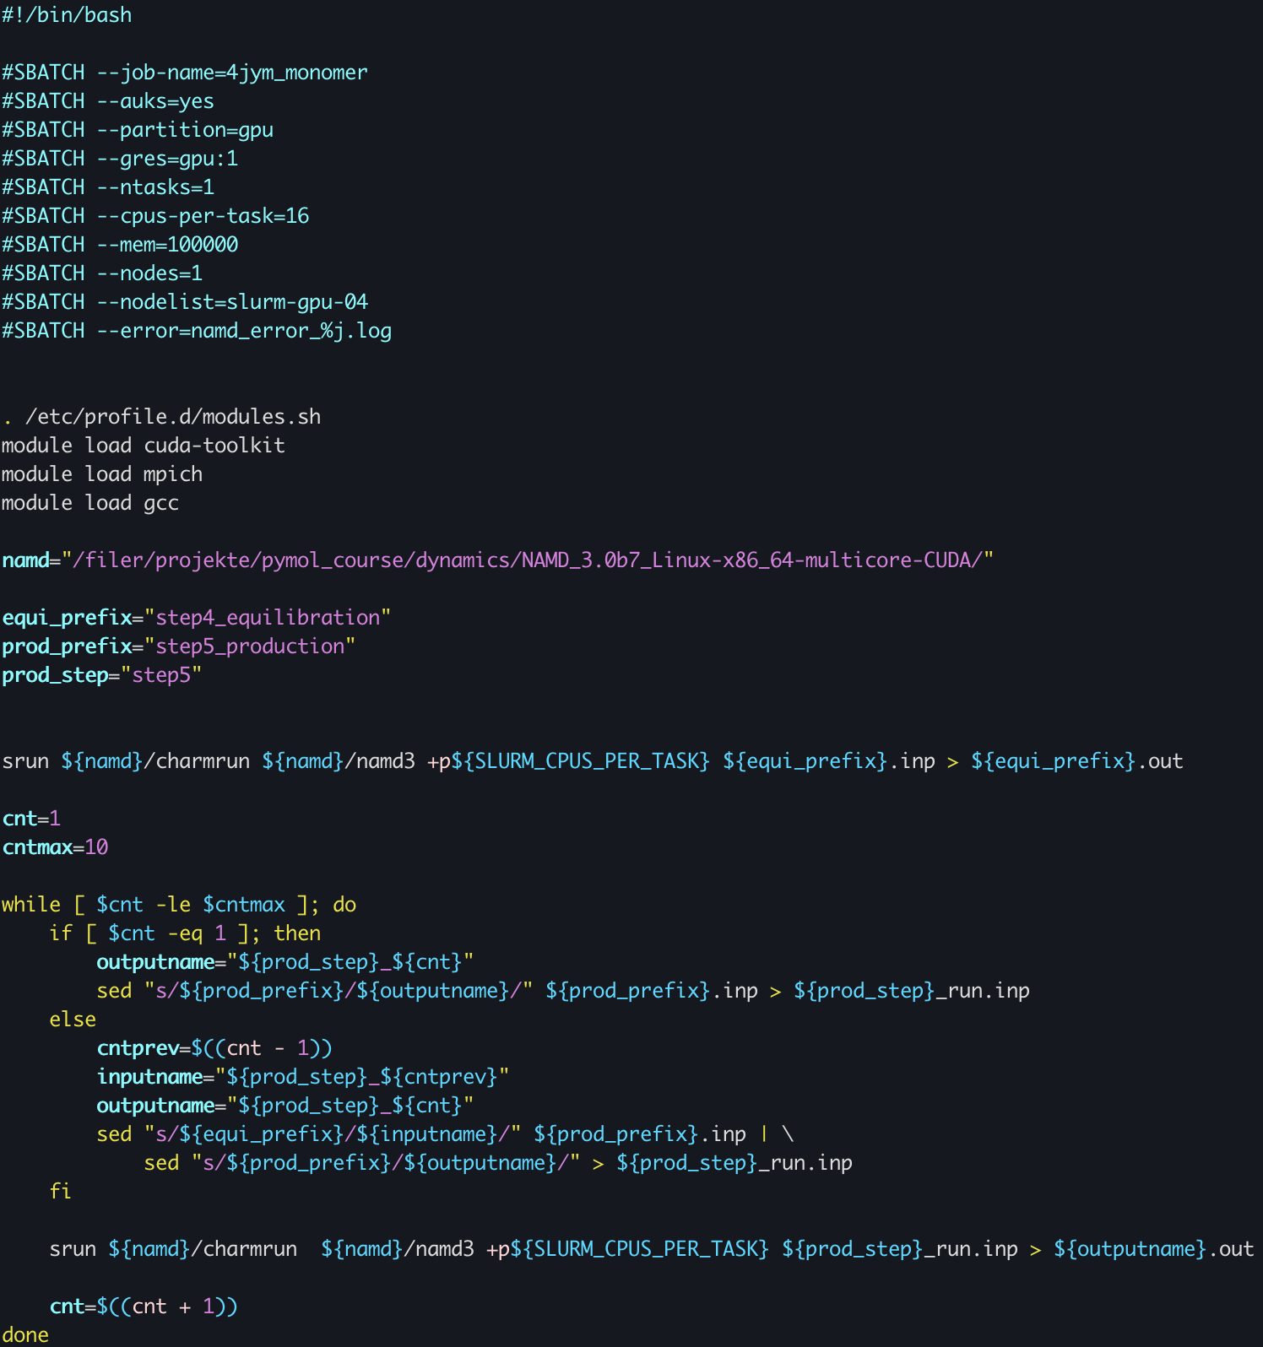
MD job submission
In /filer/projekte/pymol_course/dynamics you will find the submission file you should use: protein_md.sbatch.
Please, copy this file to your “namd” folder you have just uploaded. It should be in a directory like:
/filer/projekte/pymol_course/attendees/your_directory/your_uploaded_charm_directory/namd

Slide 73
MD job submission
The job configuration header for running it. You can change it based on your needs, but we suggest you only change the “job-name” .

Slide 74
MD job submission
These are the modules you should load to run NAMD in your area on the server. You should not change it for the tutorial.

Slide 75
MD job submission
This is the directory where NAMD is installed. You should not change it.

Slide 76
MD job submission
Defined variables. For consistency, do not change it.

Slide 77
MD job submission
This is the command to run the equilibration steps.

Slide 78
MD job submission
You can adjust the maximum number of iterations for the loop. Keep in mind that this will affect the size of your simulation. This adjustment should be combined with the “numsteps” and “run” parameters from the production input file.

Slide 79
MD job submission
You can adjust the maximum number of iterations for the loop. Keep in mind that this will affect the size of your simulation. This adjustment should be combined with the “numsteps” and “run” parameters from the production input file.
If you did not increase “numsteps” before, set this to up to 15.

Slide 80
MD job submission
After equilibration is complete, this is the loop where you will run the production steps (the actual “simulation”).

Slide 81
MD job submission
Now you can submit your job to run on our servers.

Slide 82
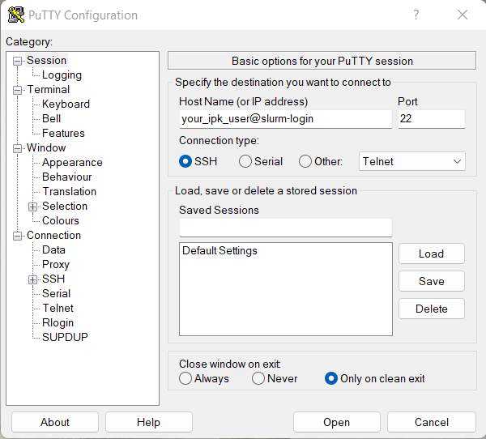
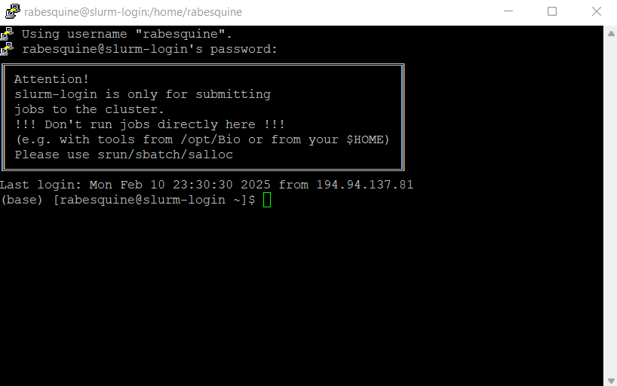
Submitting MD simulation
To submit it, you will have to use terminal to access server.
Please login using PuTTY software.

Slide 83
Submitting MD simulation
To access your “namd” folder, type:
cd /filer/projekte/pymol_course/attendees/your_directory/your_uploaded_charm_directory/namd

Slide 84
Submitting MD simulation
Once you have edited your submission file and accessed your “namd” directory, you can type:
sbatch protein_md.sbatch

Slide 85
Submitting MD simulation
Here are some useful commands that you may need when using terminal:
cd (to access a directory)
cp (to copy files)
mv (to move or rename files)
mkdir (to create a directory)
squeue --me (to check the status of your job)
scancel <job_id> (to cancel your job)

Slide 86
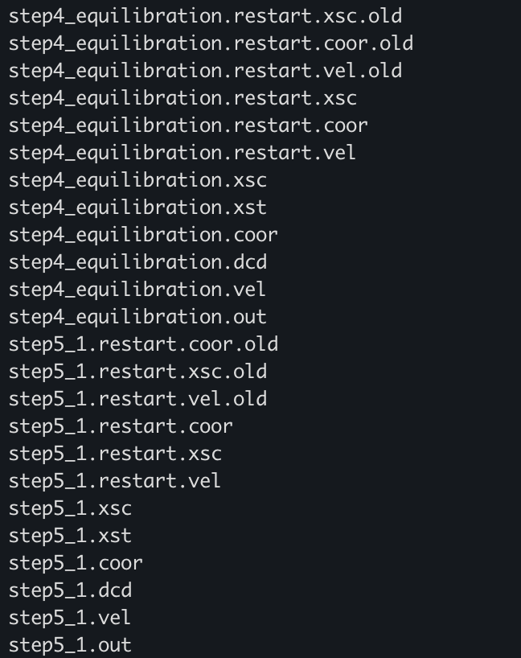
NAMD output files
While running, NAMD will output several files from both equilibration and production steps, and files to restart your simulation in case anything goes wrong.

Slide 87
NAMD output files
While running, NAMD will output several files from both equilibration and production steps, and files to restart your simulation in case anything goes wrong.
.xsc: This file stores extended system coordinates, which include the positions of all the atoms in the system, including the solvent (if present). This file is used when running simulations involving a periodic boundary condition (PBC) or when using a multi-step process that might require information about the system's box size or shape.

Slide 88
NAMD output files
While running, NAMD will output several files from both equilibration and production steps, and files to restart your simulation in case anything goes wrong.
.xst: This is the extended system trajectory file. It contains information related to the extended system in the simulation, such as the positions of particles in the system's periodic box. It stores more detailed trajectory data that might be needed when running simulations involving constraints or non-standard interactions.

Slide 89
NAMD output files
While running, NAMD will output several files from both equilibration and production steps, and files to restart your simulation in case anything goes wrong.
.coor: This file contains the coordinate data (atomic positions) at a specific time step of the simulation. It stores the positions of all the atoms in the system and can be used to restart or analyze a simulation.

Slide 90
NAMD output files
While running, NAMD will output several files from both equilibration and production steps, and files to restart your simulation in case anything goes wrong.
.dcd: This is the trajectory file, which contains a time series of atomic positions (coordinates) from the simulation.

Slide 91
NAMD output files
While running, NAMD will output several files from both equilibration and production steps, and files to restart your simulation in case anything goes wrong.
.vel: This file stores the velocity data of all the atoms at each timestep in the simulation. It is used to restart the simulation with the same velocities, or for analysis of the kinetic properties of the system.

Slide 92
NAMD output files
While running, NAMD will output several files from both equilibration and production steps, and files to restart your simulation in case anything goes wrong.
.out: This is the output log file, which contains information about the progress of the simulation, such as energy values, temperature, pressure, time steps, and other parameters. This is useful for monitoring the simulation's progress and debugging issues.

Slide 93
MD analysis
To set up the whole trajectory of our MD simulation we are going to use CPPTRAJ, a program to process coordinate trajectory and data files. It provides a great set of analysis you can perform with your MD outputs. You can check all its functionalities in its documentation.

Slide 94
MD analysis
Commands to type, sequentially, on your terminal:
module load amber
cpptraj –p step3_input.psf
trajin step5_1.dcd
trajin step5_2.dcd
trajin step5_3.dcd
trajin step5_4.dcd
trajin step5_5.dcd
trajin step5_6.dcd
trajin step5_7.dcd
trajin step5_8.dcd
trajin step5_9.dcd
trajin step5_10.dcd
autoimage
trajout dynamics_autoimage_traj.dcd
run
To set up the whole trajectory of our MD simulation we are going to use CPPTRAJ, a program to process coordinate trajectory and data files. It provides a great set of analysis you can perform with your MD outputs. You can check all its functionalities in its documentation.
First of all, we are going to use it to automatically center and image (by molecule) the trajectory with periodic boundaries conditions, by means of the “autoimage” function.

Slide 95
MD analysis
Commands to type, sequentially, on your terminal:
module load amber
cpptraj –p step3_input.psf
trajin step5_1.dcd
trajin step5_2.dcd
trajin step5_3.dcd
trajin step5_4.dcd
trajin step5_5.dcd
trajin step5_6.dcd
trajin step5_7.dcd
trajin step5_8.dcd
trajin step5_9.dcd
trajin step5_10.dcd
autoimage
trajout dynamics_autoimage_traj.dcd
run
To set up the whole trajectory of our MD simulation we are going to use CPPTRAJ, a program to process coordinate trajectory and data files. It provides a great set of analysis you can perform with your MD outputs. You can check all its functionalities in its documentation.
First of all, we are going to use it to automatically center and image (by molecule) the trajectory with periodic boundaries conditions, by means of the “autoimage” function.
We can use Pymol visualize this imaged trajectory. (Copy the auto imaged .dcd file and the step3_input.pdb file to your local computer.)

Slide 96
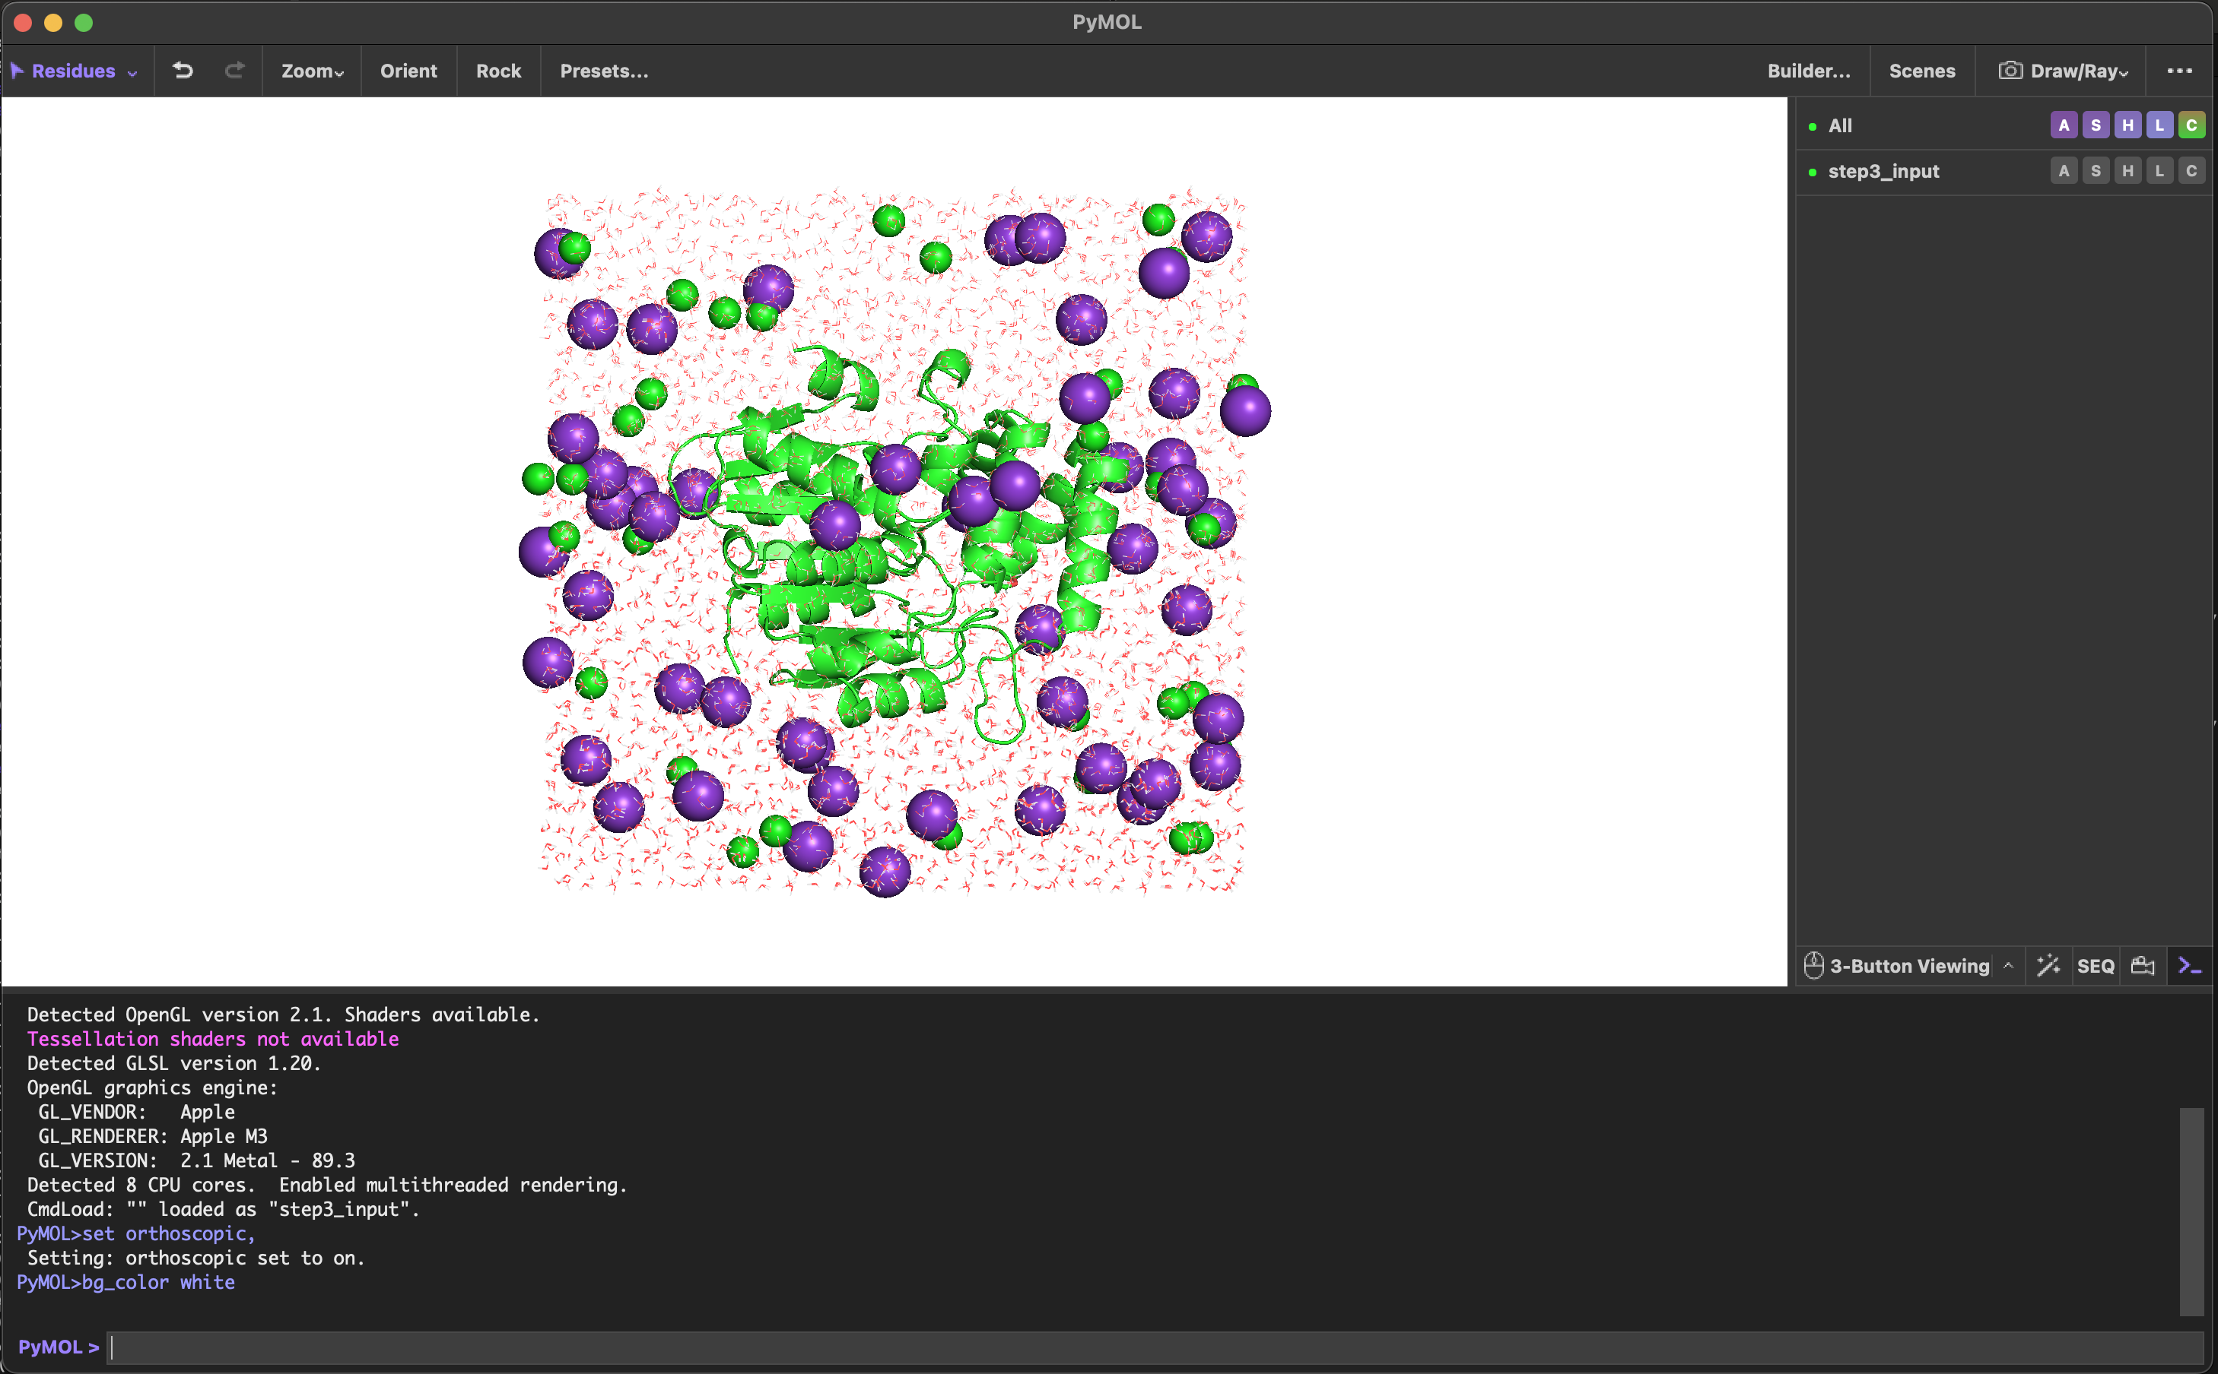
MD analysis
1) On Pymol, upload the step3_input.pdb
Commands to type, sequentially, on your terminal:
cpptraj –p step3_input.psf
trajin step5_1.dcd
trajin step5_2.dcd
trajin step5_3.dcd
trajin step5_4.dcd
trajin step5_5.dcd
trajin step5_6.dcd
trajin step5_7.dcd
trajin step5_8.dcd
trajin step5_9.dcd
trajin step5_10.dcd
autoimage
trajout dynamics_autoimage_traj.dcd
run
To set up the whole trajectory of our MD simulation we are going to use CPPTRAJ, a program to process coordinate trajectory and data files. It provides a great set of analysis you can perform with your MD outputs. You can check all its functionalities in its documentation.
First of all, we are going to use it to automatically center and image (by molecule) the trajectory with periodic boundaries conditions, by means of the “autoimage” function.
We can use Pymol visualize this imaged trajectory.

Slide 97
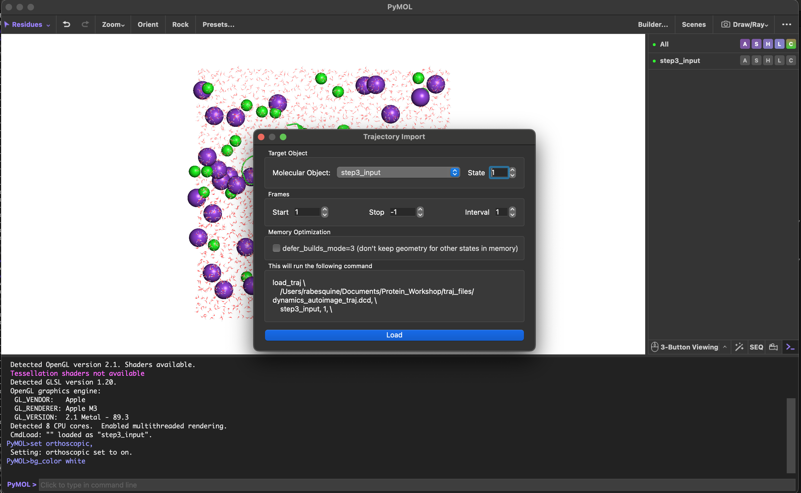
MD analysis
2) Upload the .dcd file
Commands to type, sequentially, on your terminal:
cpptraj –p step3_input.psf
trajin step5_1.dcd
trajin step5_2.dcd
trajin step5_3.dcd
trajin step5_4.dcd
trajin step5_5.dcd
trajin step5_6.dcd
trajin step5_7.dcd
trajin step5_8.dcd
trajin step5_9.dcd
trajin step5_10.dcd
autoimage
trajout dynamics_autoimage_traj.dcd
run
To set up the whole trajectory of our MD simulation we are going to use CPPTRAJ, a program to process coordinate trajectory and data files. It provides a great set of analysis you can perform with your MD outputs. You can check all its functionalities in its documentation.
First of all, we are going to use it to automatically center and image (by molecule) the trajectory with periodic boundaries conditions, by means of the “autoimage” function.
We can use Pymol visualize this imaged trajectory.

Slide 98
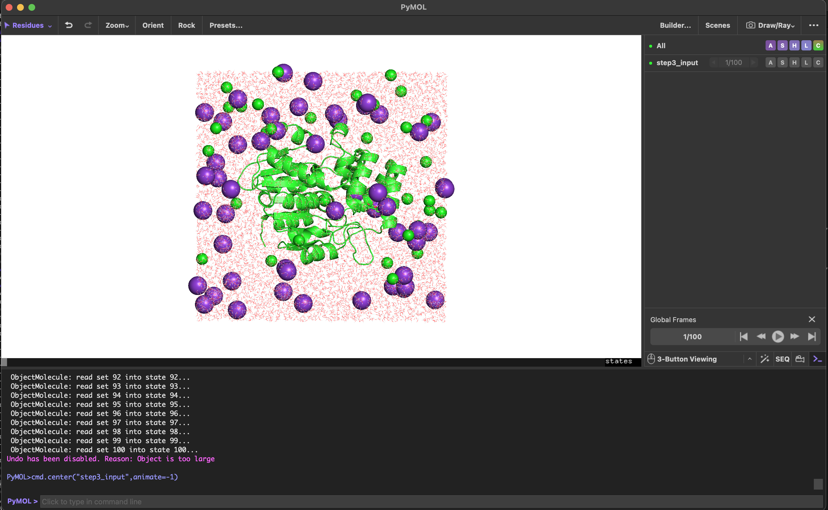
MD analysis
2) Upload the .dcd file
Commands to type, sequentially, on your terminal:
cpptraj –p step3_input.psf
trajin step5_1.dcd
trajin step5_2.dcd
trajin step5_3.dcd
trajin step5_4.dcd
trajin step5_5.dcd
trajin step5_6.dcd
trajin step5_7.dcd
trajin step5_8.dcd
trajin step5_9.dcd
trajin step5_10.dcd
autoimage
trajout dynamics_autoimage_traj.dcd
run
To set up the whole trajectory of our MD simulation we are going to use CPPTRAJ, a program to process coordinate trajectory and data files. It provides a great set of analysis you can perform with your MD outputs. You can check all its functionalities in its documentation.
First of all, we are going to use it to automatically center and image (by molecule) the trajectory with periodic boundaries conditions, by means of the “autoimage” function.
We can use Pymol visualize this imaged trajectory.

Slide 99
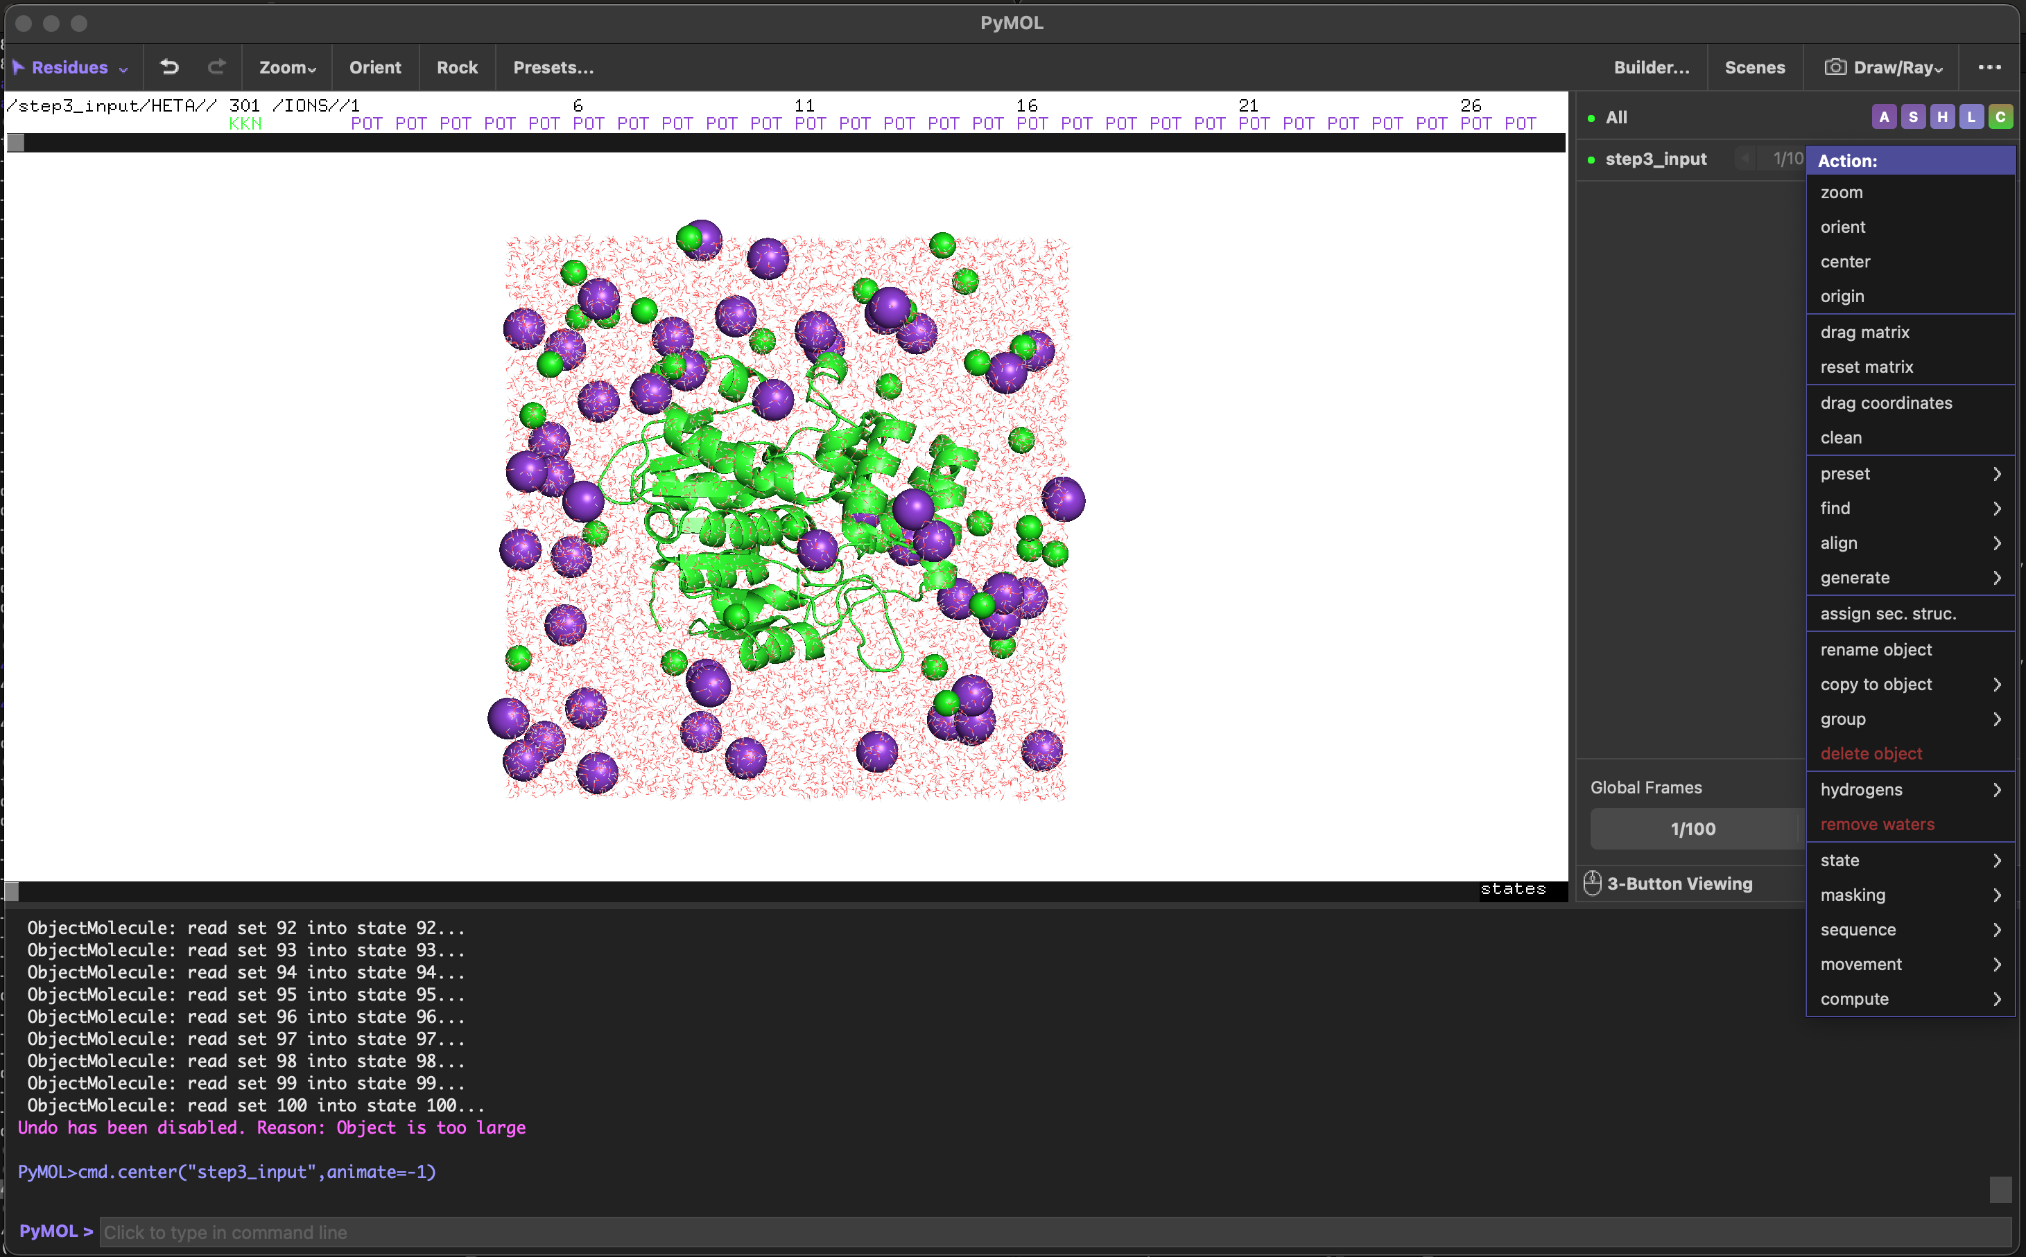
MD analysis
3) Remove water molecules
Commands to type, sequentially, on your terminal:
cpptraj –p step3_input.psf
trajin step5_1.dcd
trajin step5_2.dcd
trajin step5_3.dcd
trajin step5_4.dcd
trajin step5_5.dcd
trajin step5_6.dcd
trajin step5_7.dcd
trajin step5_8.dcd
trajin step5_9.dcd
trajin step5_10.dcd
autoimage
trajout dynamics_autoimage_traj.dcd
run
To set up the whole trajectory of our MD simulation we are going to use CPPTRAJ, a program to process coordinate trajectory and data files. It provides a great set of analysis you can perform with your MD outputs. You can check all its functionalities in its documentation.
First of all, we are going to use it to automatically center and image (by molecule) the trajectory with periodic boundaries conditions, by means of the “autoimage” function.
We can use Pymol visualize this imaged trajectory.

Slide 100
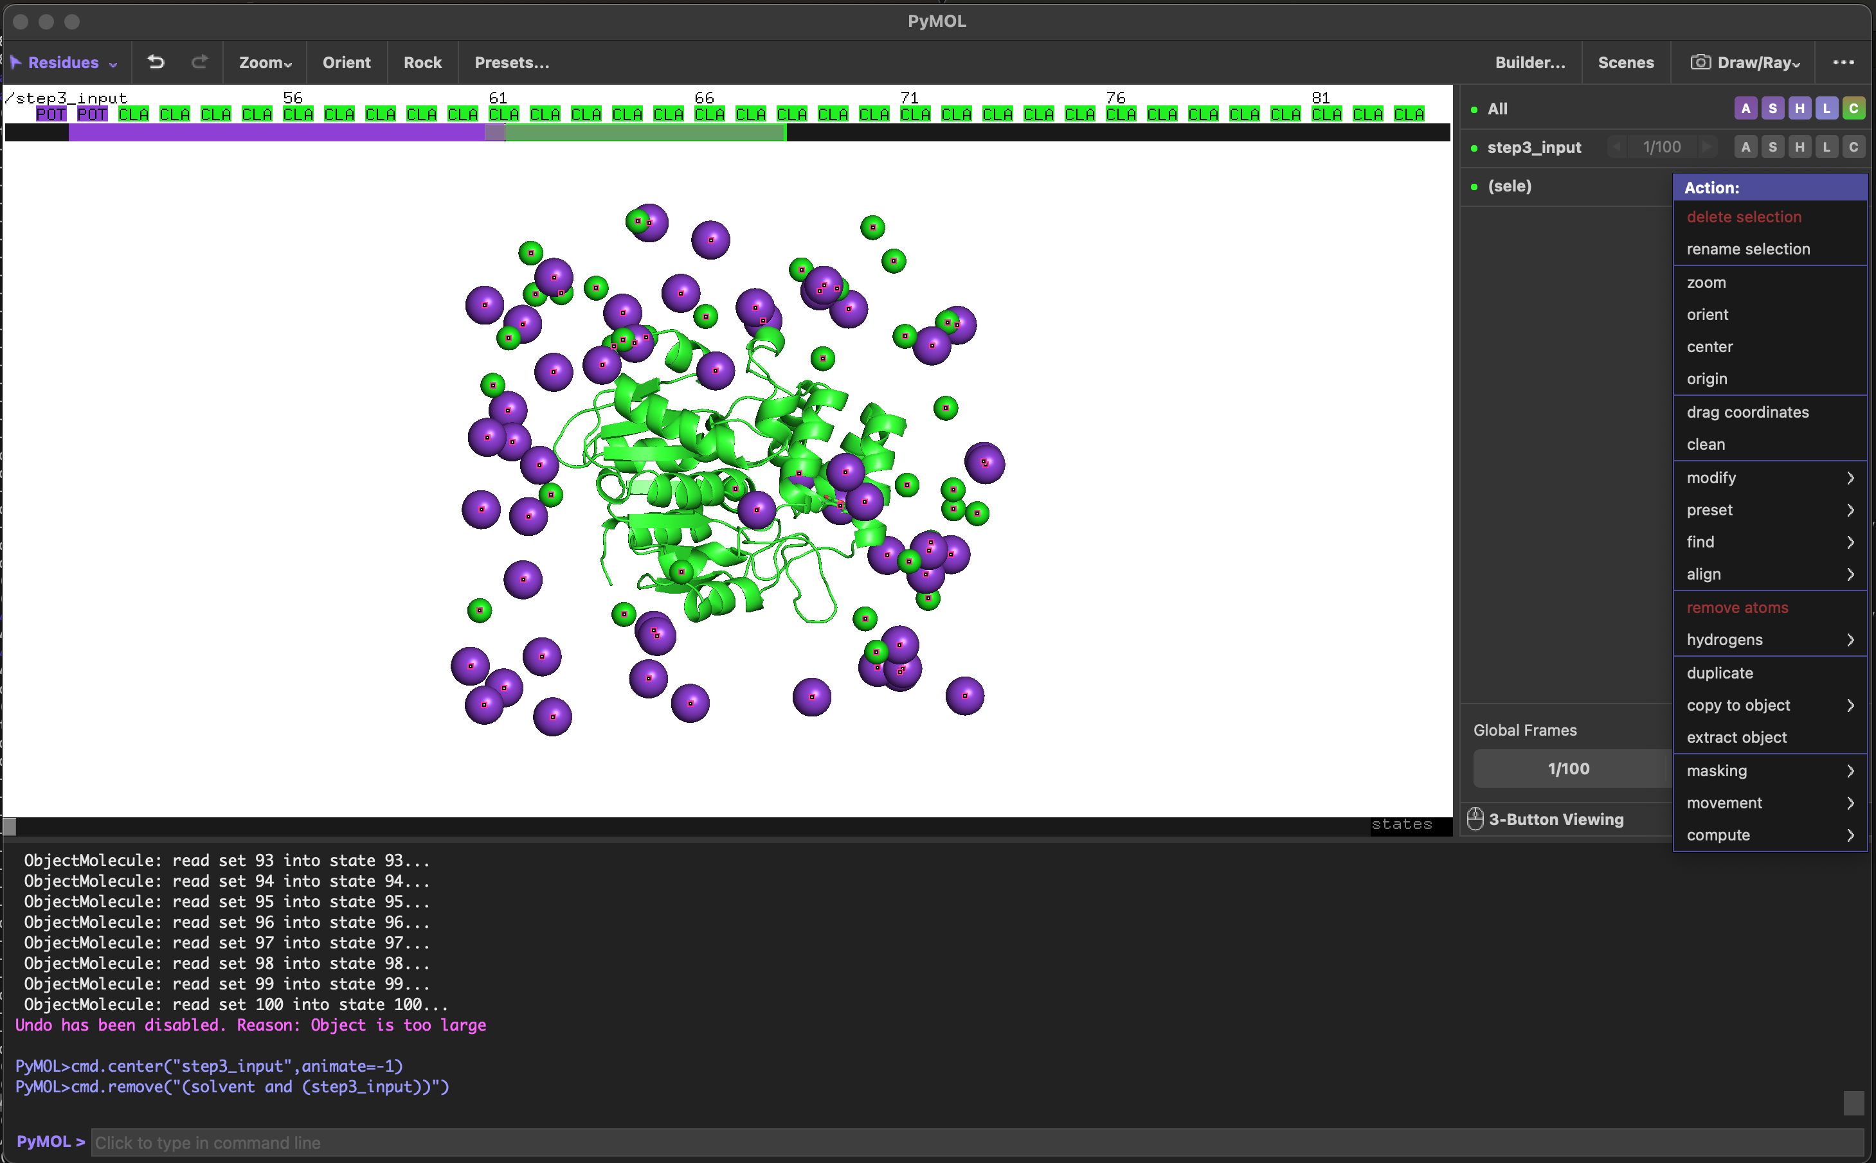
MD analysis
4) Remove ions
Commands to type, sequentially, on your terminal:
cpptraj –p step3_input.psf
trajin step5_1.dcd
trajin step5_2.dcd
trajin step5_3.dcd
trajin step5_4.dcd
trajin step5_5.dcd
trajin step5_6.dcd
trajin step5_7.dcd
trajin step5_8.dcd
trajin step5_9.dcd
trajin step5_10.dcd
autoimage
trajout dynamics_autoimage_traj.dcd
run
To set up the whole trajectory of our MD simulation we are going to use CPPTRAJ, a program to process coordinate trajectory and data files. It provides a great set of analysis you can perform with your MD outputs. You can check all its functionalities in its documentation.
First of all, we are going to use it to automatically center and image (by molecule) the trajectory with periodic boundaries conditions, by means of the “autoimage” function.
We can use Pymol visualize this imaged trajectory.

Slide 101
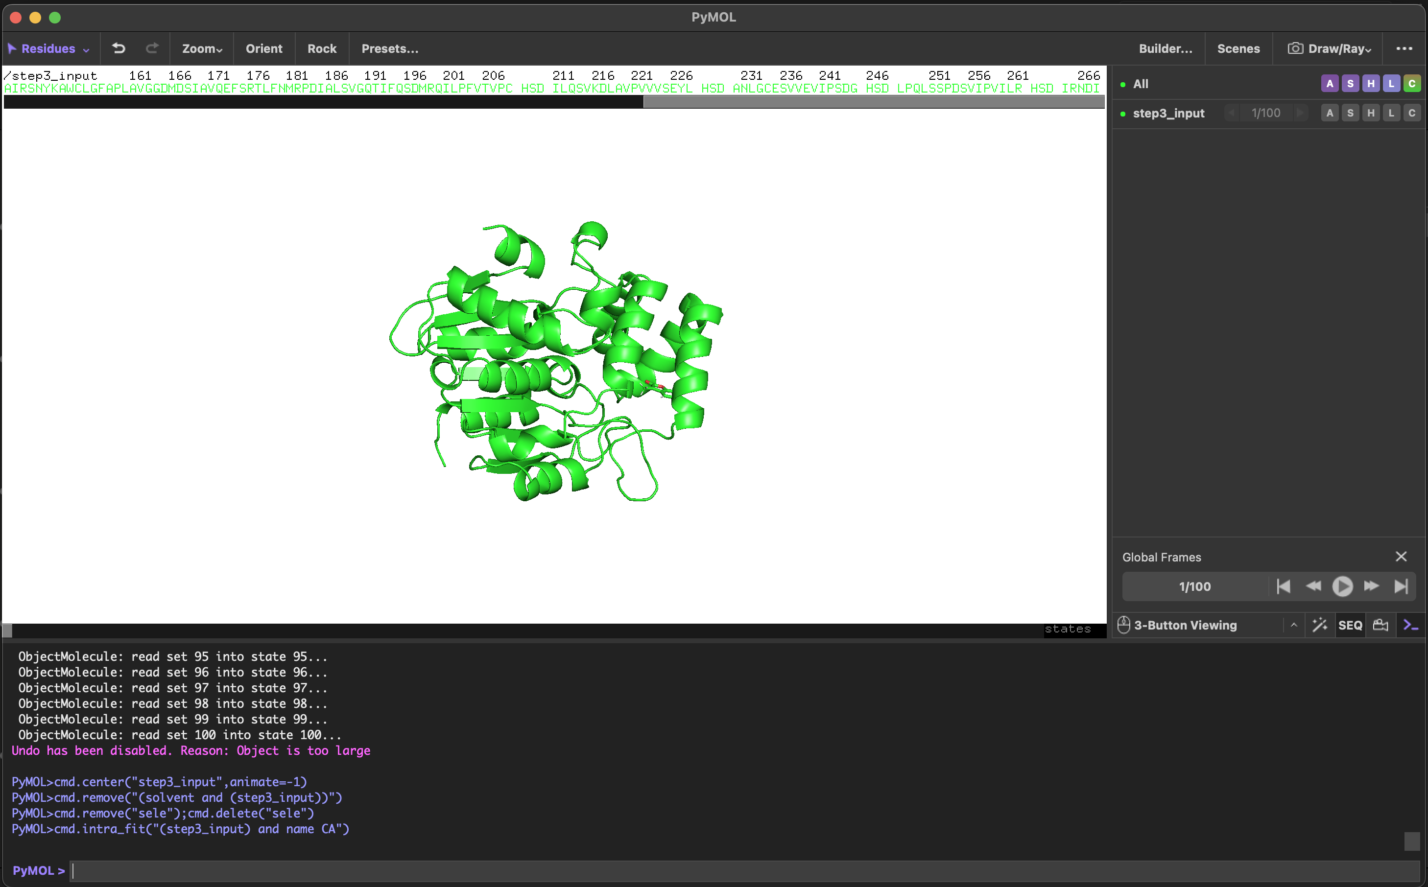
MD analysis
4) Visualize trajectory video
Commands to type, sequentially, on your terminal:
cpptraj –p step3_input.psf
trajin step5_1.dcd
trajin step5_2.dcd
trajin step5_3.dcd
trajin step5_4.dcd
trajin step5_5.dcd
trajin step5_6.dcd
trajin step5_7.dcd
trajin step5_8.dcd
trajin step5_9.dcd
trajin step5_10.dcd
autoimage
trajout dynamics_autoimage_traj.dcd
run
To set up the whole trajectory of our MD simulation we are going to use CPPTRAJ, a program to process coordinate trajectory and data files. It provides a great set of analysis you can perform with your MD outputs. You can check all its functionalities in its documentation.
First of all, we are going to use it to automatically center and image (by molecule) the trajectory with periodic boundaries conditions, by means of the “autoimage” function.
We can use Pymol visualize this imaged trajectory.

Slide 102
MD analysis
Commands to type, sequentially, on your terminal:
cpptraj –p step3_input.psf
trajin dynamics_autoimage_traj.dcd
rms first complex_rmsd : <first_residue_number>-<last_residue_number>@CA,C,N out complex_rmsd.txt
rms first ligand_rmsd :<ligand_residue_number> out ligand_rmsd.txt
strip :WAT,Na+,Cl-
atomicfluct out protein_rmsf.dat byres :<first_residue_number>-<last_residue_number>
run
To set up the whole trajectory of our MD simulation we are going to use CPPTRAJ, a program to process coordinate trajectory and data files. It provides a great set of analysis you can perform with your MD outputs. You can check all its functionalities in its documentation.
First of all, we are going to use it to automatically center and image (by molecule) the trajectory with periodic boundaries conditions, by means of the “autoimage” function.
From the auto imaged trajectory, we are going to compute the RMSD for both the complex and the ligand, with respect to the first frame, and the RMSF, or atomic fluctuation, per amino acid residue.
Copy the .dat from your area on server to your local computer so we can take a look at it.

Slide 103
MD analysis
Commands to type, sequentially, on your terminal:
cpptraj –p step3_input.psf
trajin dynamics_autoimage_traj.dcd
rms first complex_rmsd : <first_residue_number>-<last_residue_number>@CA,C,N out complex_rmsd.txt
rms first ligand_rmsd :<ligand_residue_number> out ligand_rmsd.txt
strip :WAT,Na+,Cl-
atomicfluct out protein_rmsf.dat byres :<first_residue_number>-<last_residue_number>
run
To set up the whole trajectory of our MD simulation we are going to use CPPTRAJ, a program to process coordinate trajectory and data files. It provides a great set of analysis you can perform with your MD outputs. You can check all its functionalities in its documentation.
First of all, we are going to use it to automatically center and image (by molecule) the trajectory with periodic boundaries conditions, by means of the “autoimage” function.
From the auto imaged trajectory, we are going to compute the RMSD for both the complex and the ligand, with respect to the first frame, and the RMSF, or atomic fluctuation, per amino acid residue.
Copy the .dat from your area on server to your local computer so we can take a look at it.

Slide 104
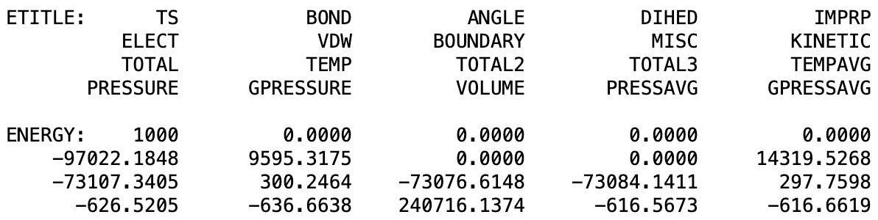
MD analysis
The output log contains information about the progress of the simulation, such as energy values, temperature, pressure, time steps, and other parameters. We can analyze it during simulations, and after it.
(example from simulation of pure, rigid water)

Slide 105
MD analysis
The output log contains information about the progress of the simulation, such as energy values, temperature, pressure, time steps, and other parameters. We can analyze it during simulations, and after it.
(example from simulation of pure, rigid water)
On terminal, type:
python merge_log_2.py output_log.txt <num_steps>
Copy your output_log.txt file from your area on server to your local computer so we can take a look at it.

